Slide 1

Privacy & Security of IoT
Suma Garuda
Mohsen Aghashahi

Slide 2
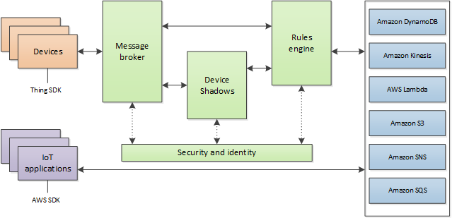
Architecture

Slide 3
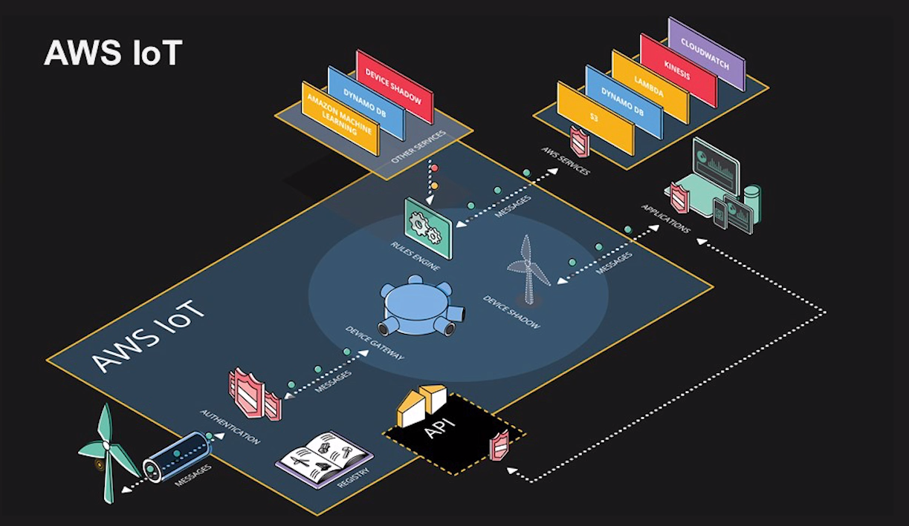

Slide 4
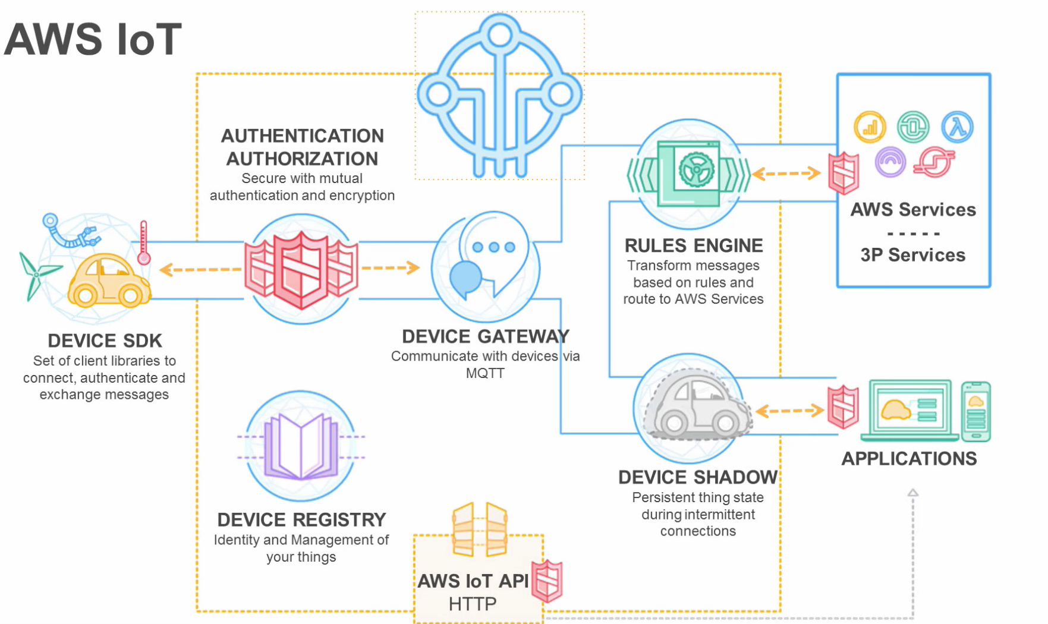

Slide 5
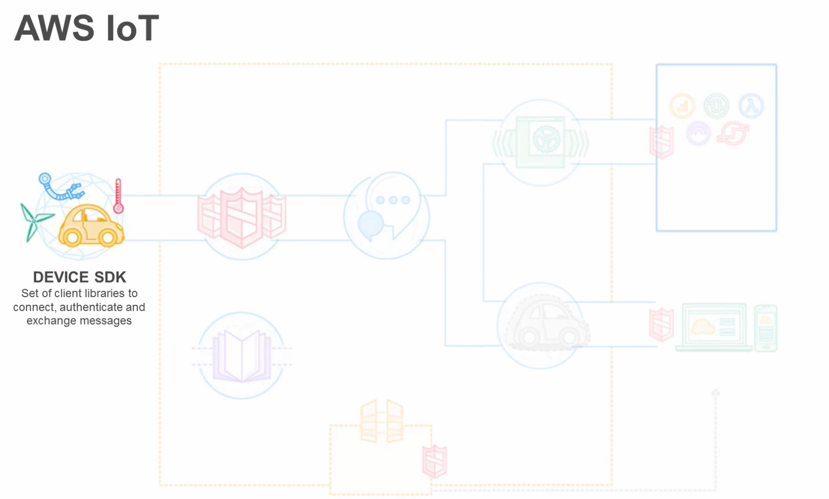
Set up codes in device to connect with AWS IoT

Slide 6
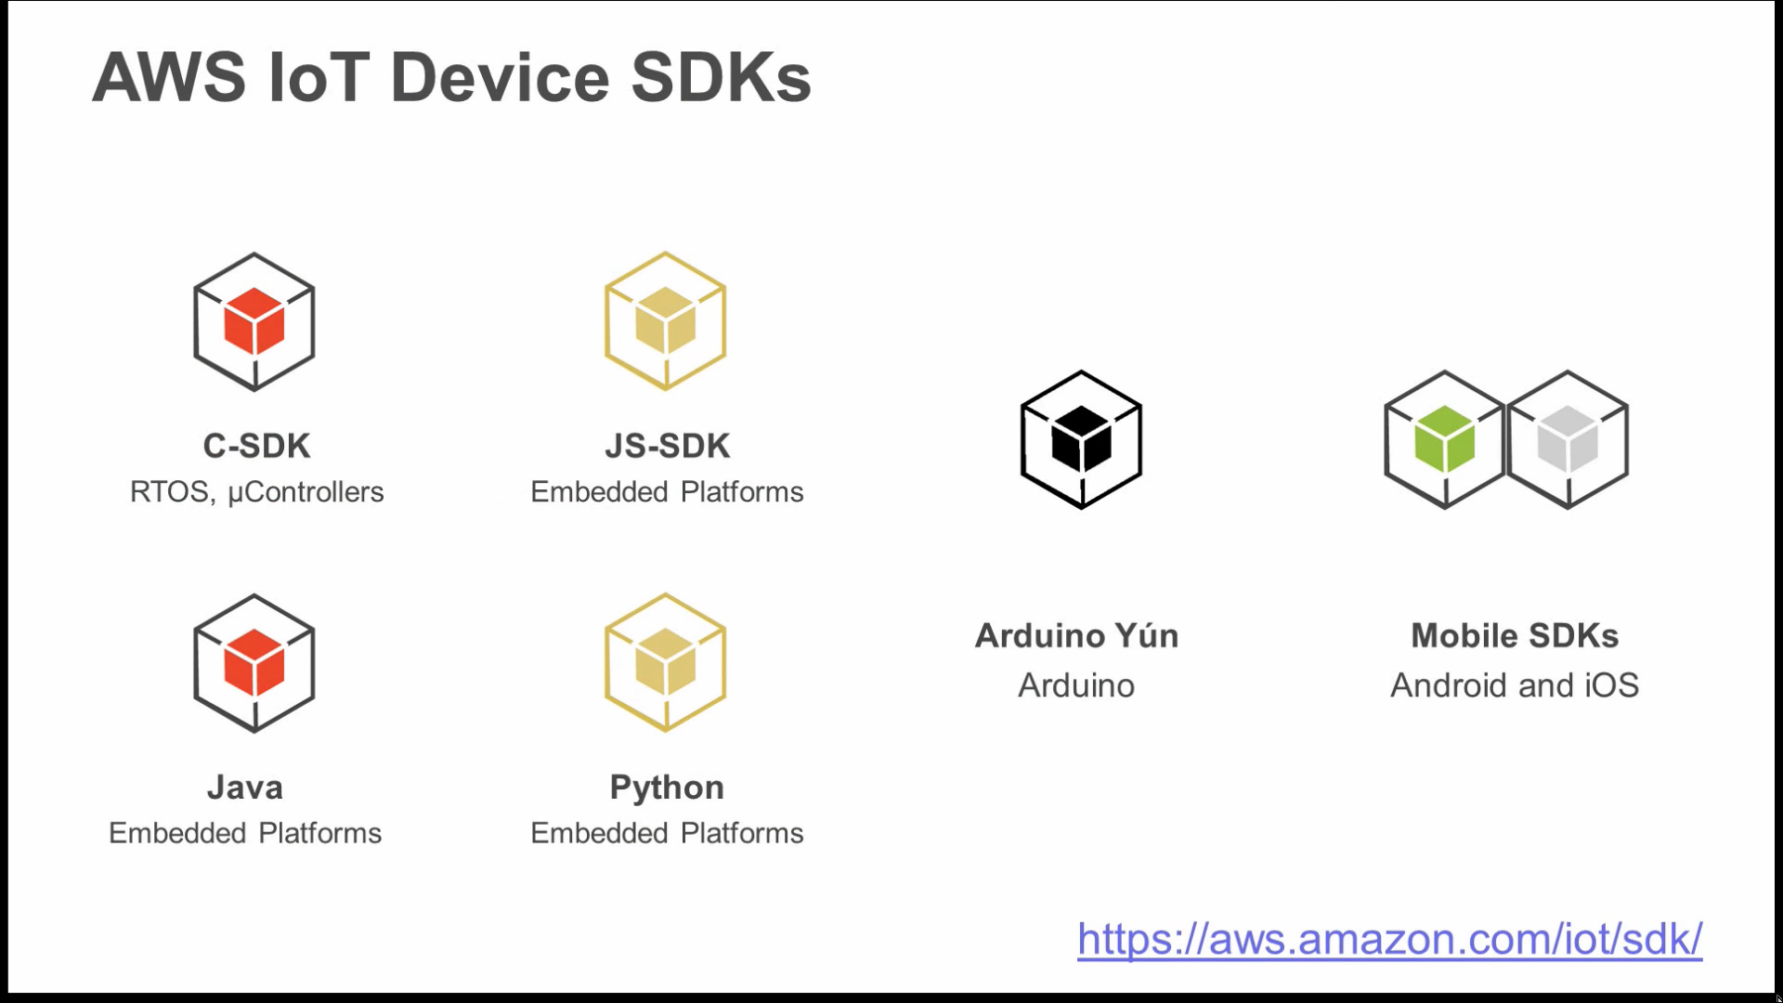

Slide 7
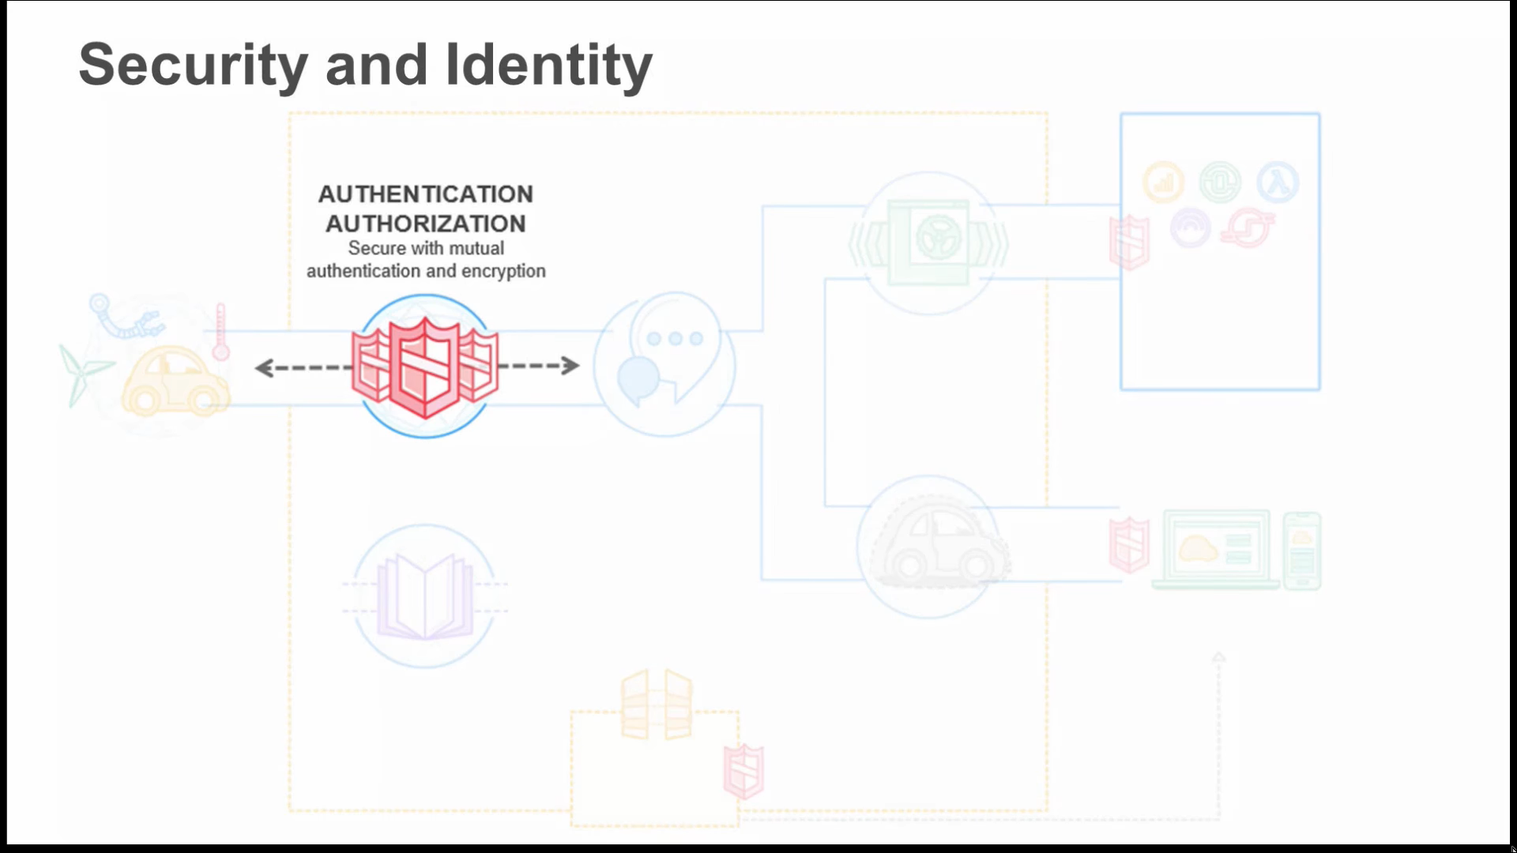

Slide 8
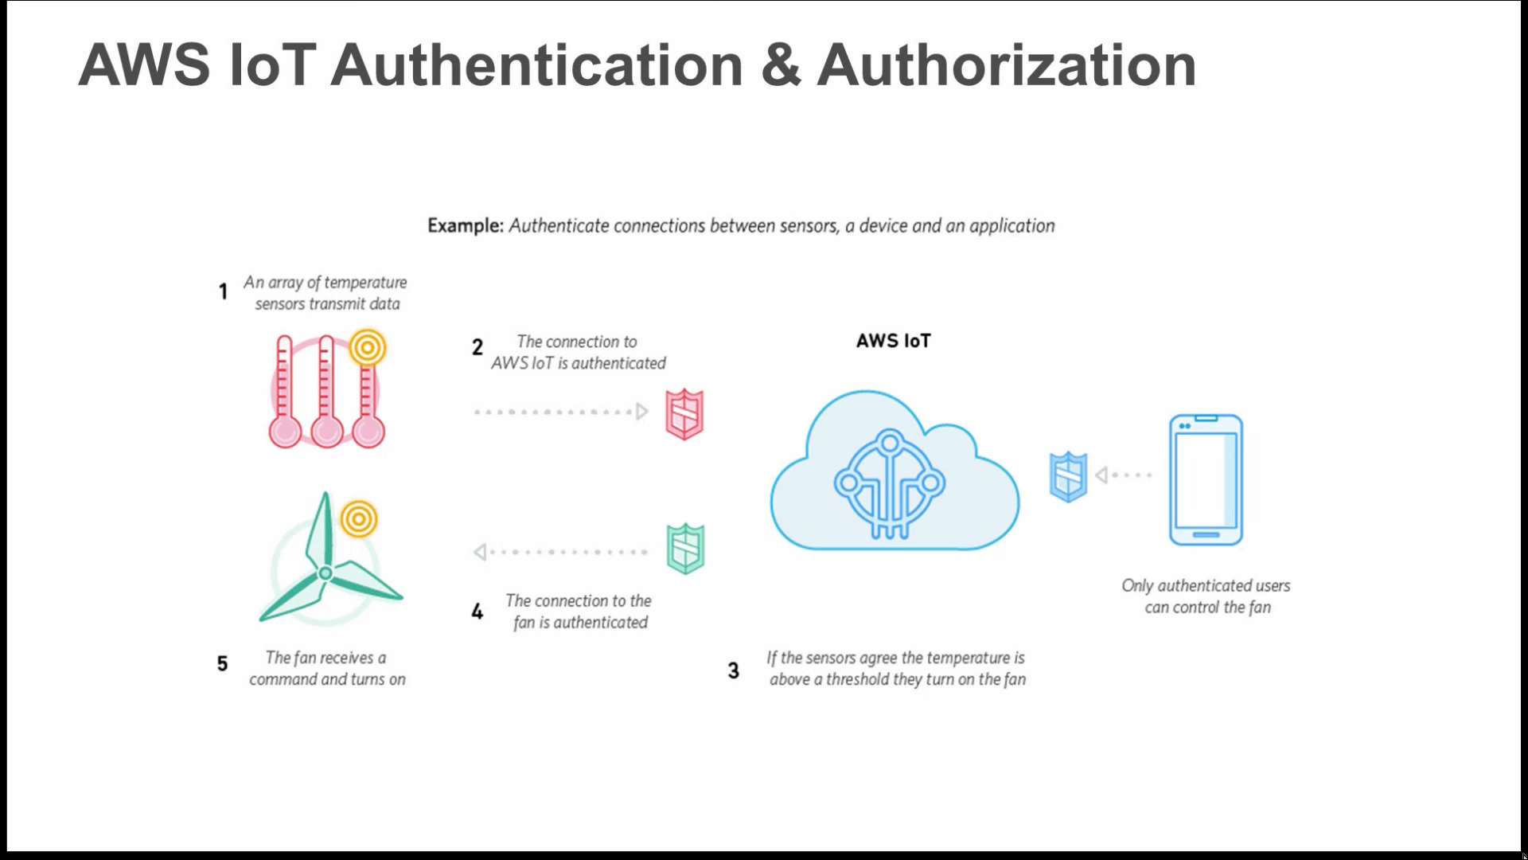
E.g.: Fan cannot listen to sensor User cannot publish data, but can listen to both

Slide 9
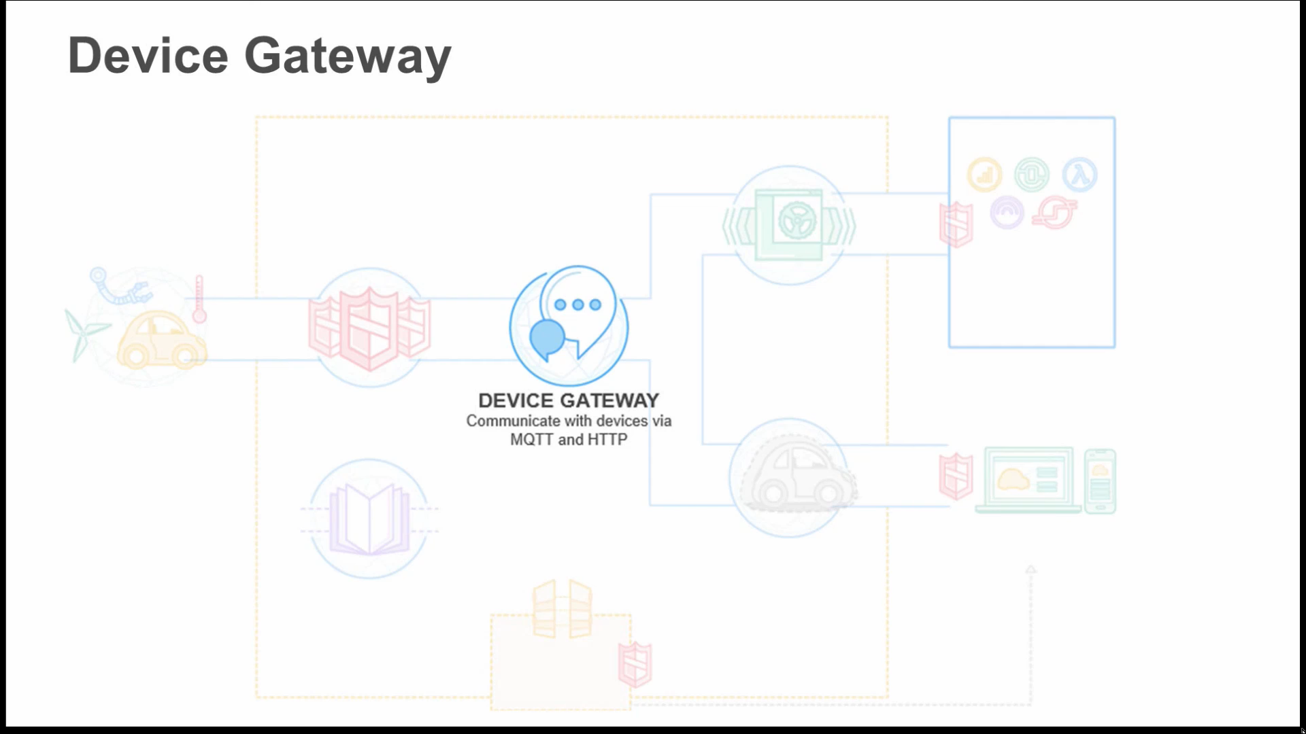
& Websocket

Slide 10
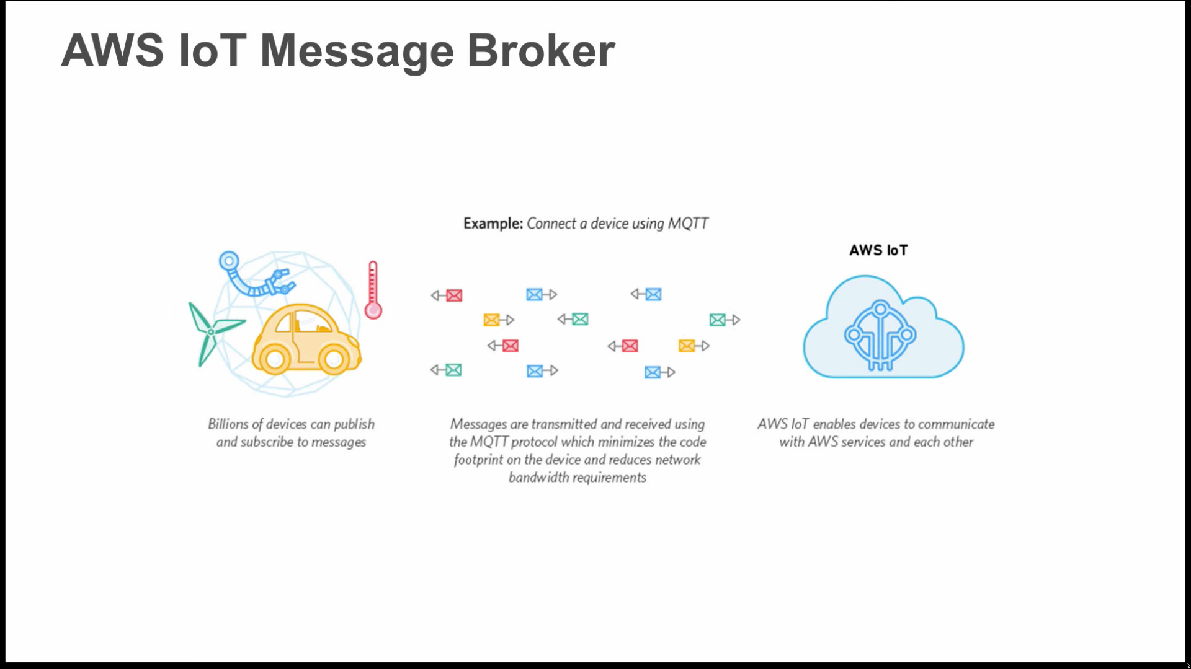

Slide 11
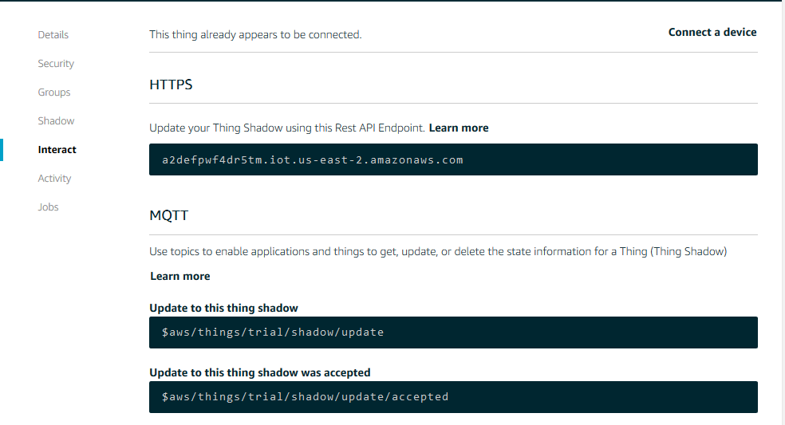

Slide 12
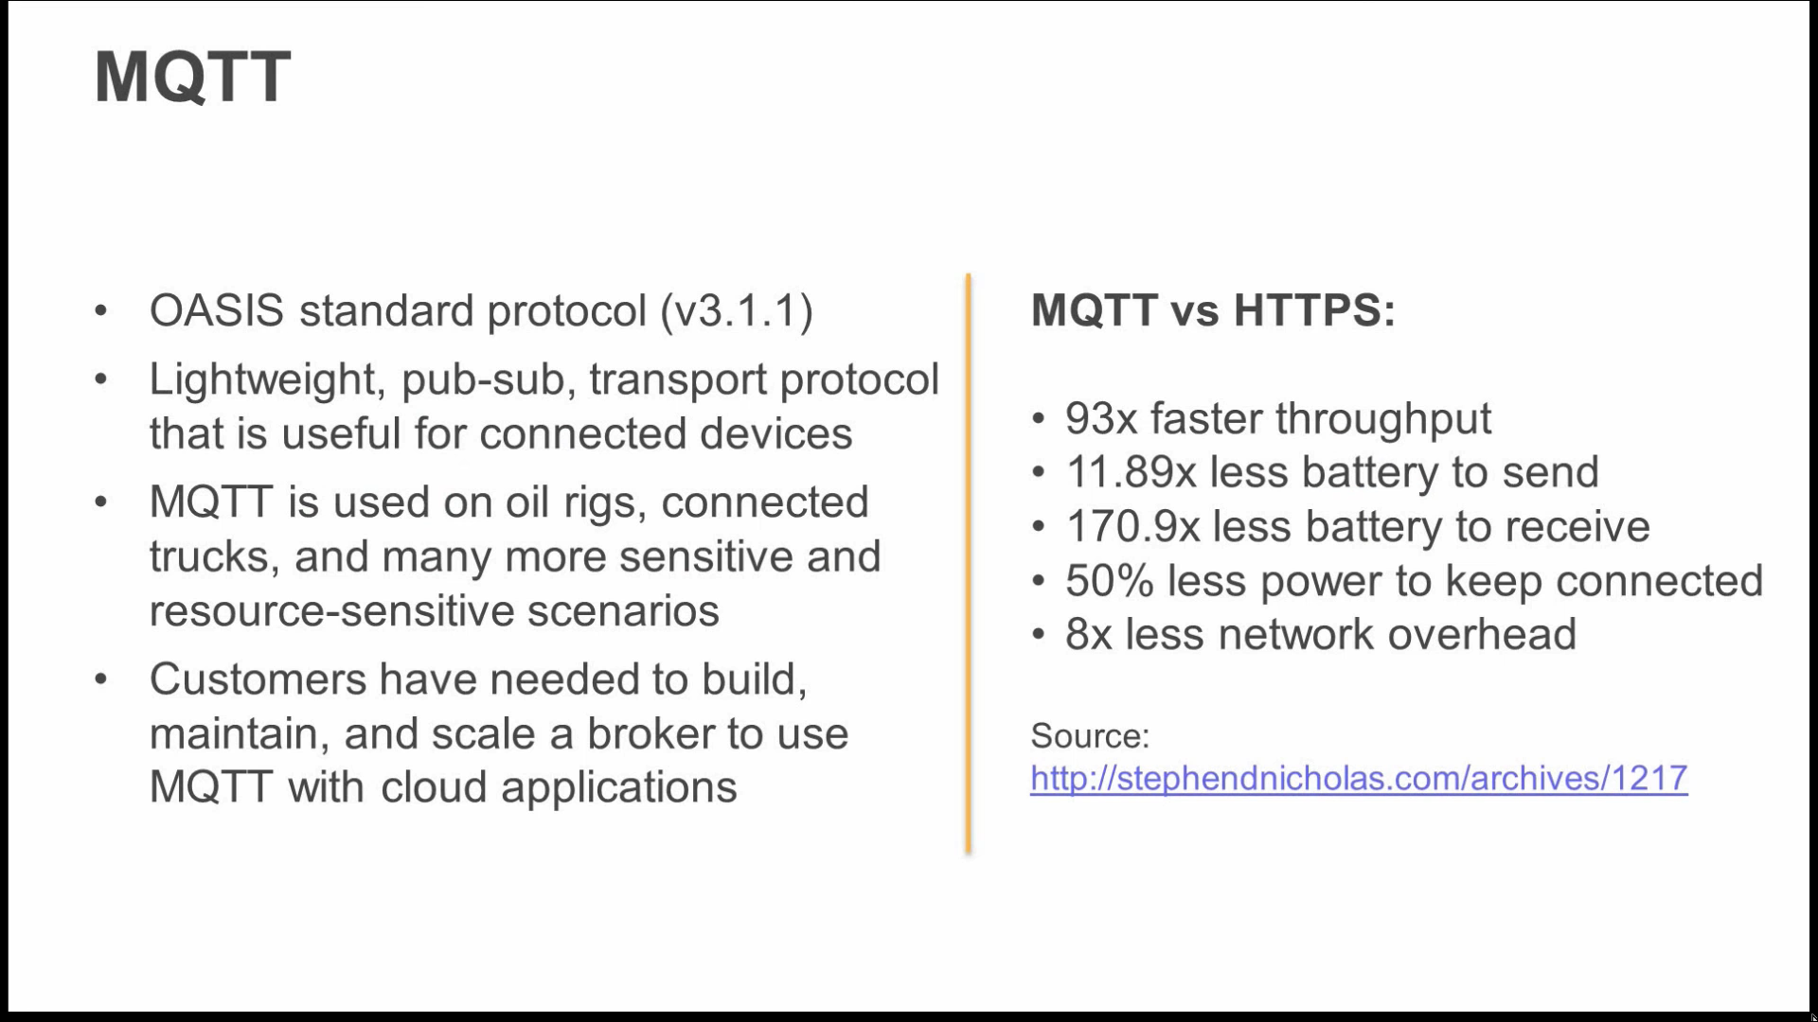

Slide 13
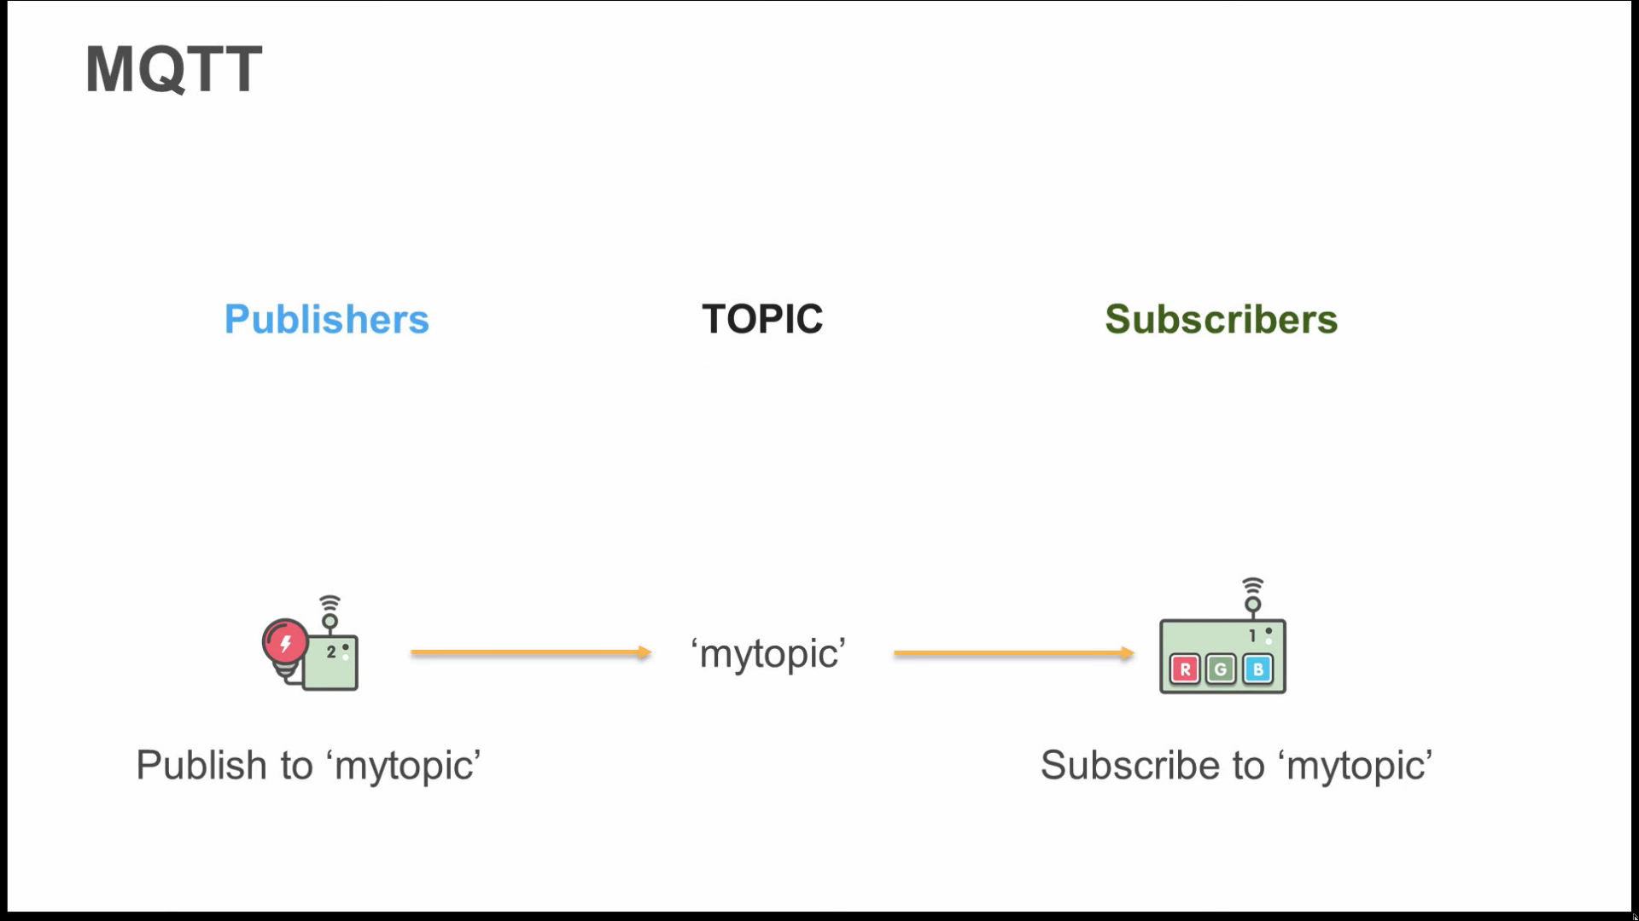

Slide 14
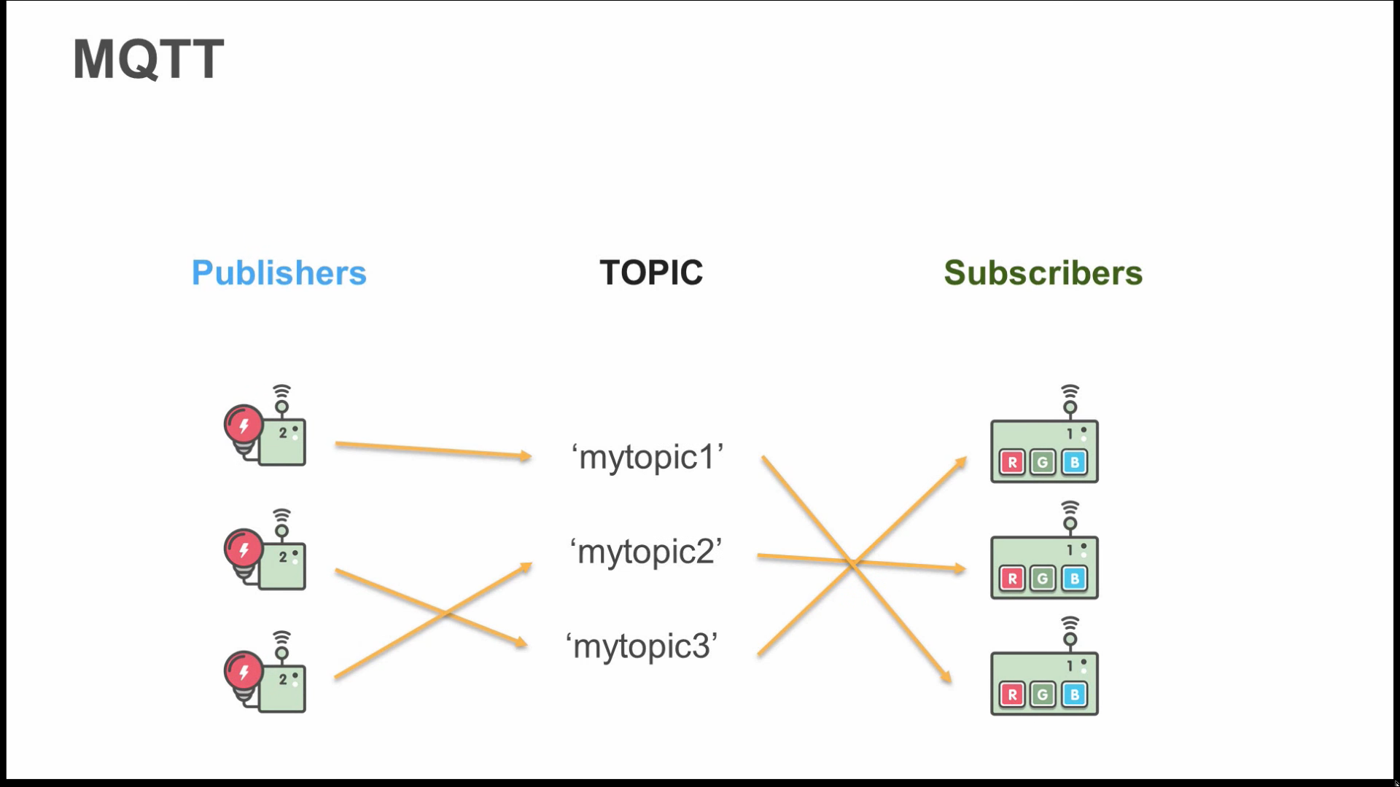

Slide 15
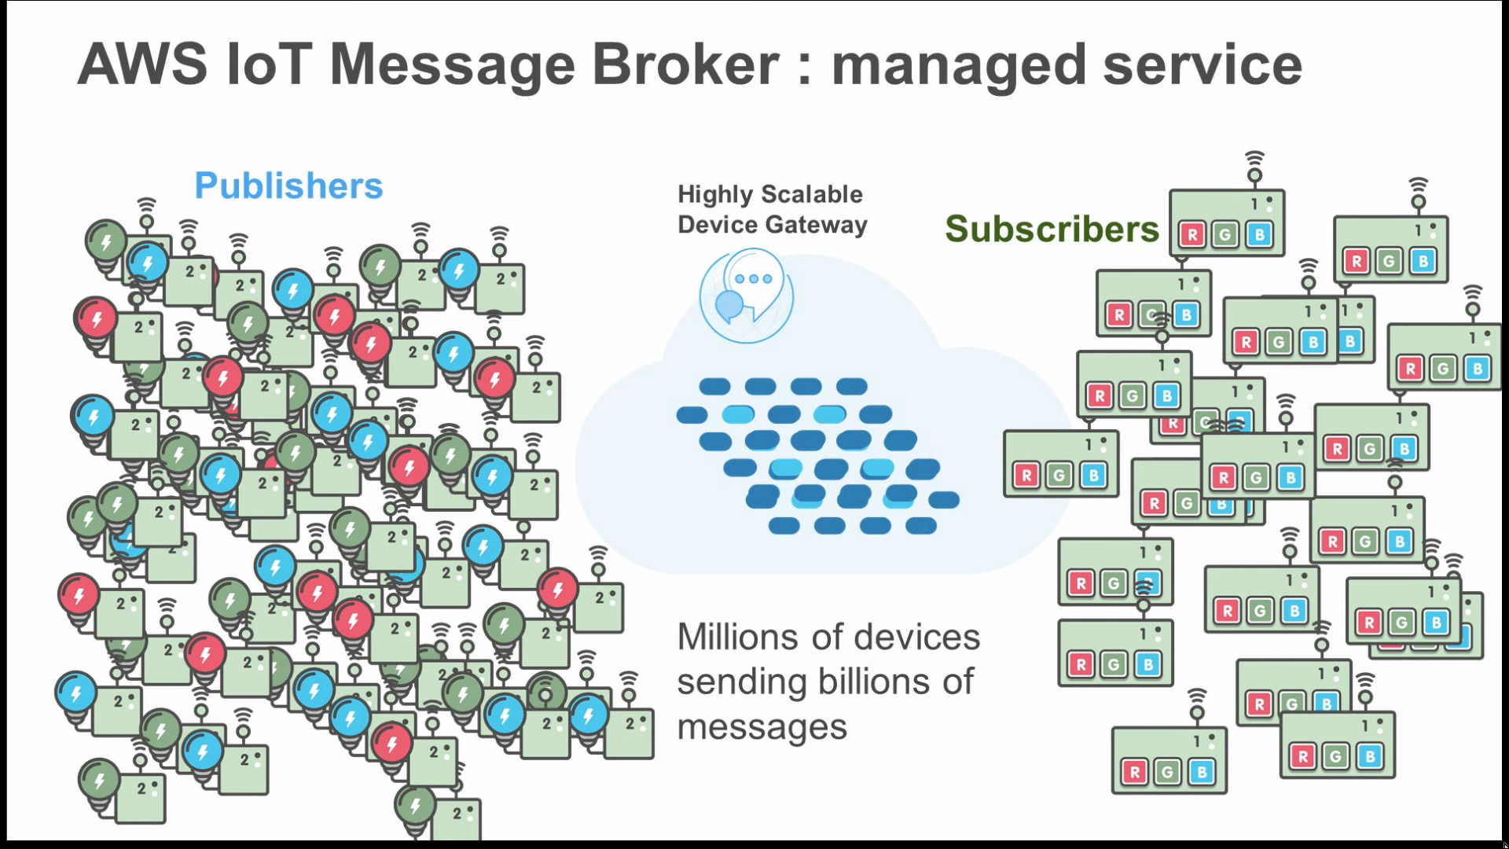

Slide 16
Security and Identity for AwS IoT
Each connected device has a credential to access the message broker or the Device Shadow service.
All traffic to and from AWS IoT is encrypted over TLS v1.2.
Message broker connections over HTTP: AWS IoT authentication using the Signature Version 4 signing.
Verify the identity of the requester
Protect data in transit (data sent along with its hashed version sing some of the request elements)
Protect against potential replay attacks (within five minutes of timestamp)
Notes:
TLS is used to ensure the confidentiality of the application protocols (MQTT, HTTP) supported by AWS IoT.
TLS client authentication is used by AWS IoT to identify devices.
TLS encrypts the connection between the device and broker.
Authentication is delegated to AWS Signature Version 4.
TLS Cipher Suite Support:
ECDHE-ECDSA-AES128-GCM-SHA256
ECDHE-RSA-AES128-GCM-SHA256

Slide 17
AWS IoT Authentication
X.509 certificates
IAM users, groups and roles
Amazon Cognito identities
Federated identities
Notes:
AWS IoT devices use X.509 applications
Mobile applications use Amazon Cognito devices
Web and desktop applications use IAM or federated identities.

Slide 18
X.509 Certificates
Digital Certificates – X.509 public key infrastructure standard to associate a public key with an identity contained in a certificate.
Issued by a CA
Issued to each device – for fine grained management including certificate revocation
Support for rotation and replacement of certificates
Better than identification and authentication mechanisms because of the use of asymmetric keys (private keys can be burnt into secure storage on a device- sensitive cryptographic material never leaves the device)
Certificate Signing Algorithms: SHA256WITHRSA, ECDSA-WITH-SHA512
Notes:
Clients must support: TLS 1.2, SHA 256 RSA certificate signature validation, TLS cipher suite support

Slide 19
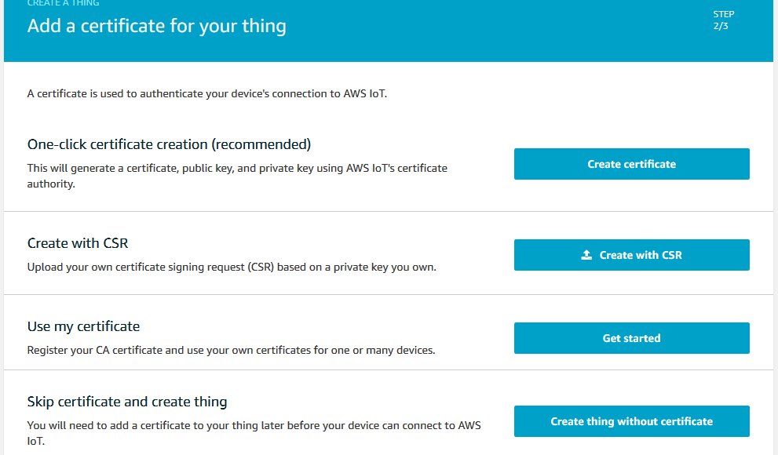

Slide 20
IAM Users, Groups, and Roles
For identity and access management in AWS
Also allow access to other AWS resources (eg. Publishing state with Dynamo DB)
Identified by name, Amazon resource name (ARN), password, access keys, SSH keys etc.
Works on the principle of least privilege.
Notes:
When we use the AWS CLI or any of the AWS SDK’s, these tools automatically sign the HTTP requests for us, with the access key that we specify when we configure the tools.
Signing: first calculate a hash (digest) of the request. Then use the hash value and some other information from the request, and your secret access key to calculate another hash known as signature. This signature is then added to the HTTP authorization header or as a query string value.

Slide 21
Amazon Cognito Identities
Exchange a token from your identity provider (or Login with Amazon, Facebook or Google) for AWS security credentials.
The credentials are used for role based access control
Give the users a set of temporary, limited privilege credentials to access AWS resources. (Defining IAM roles)
AWS IoT allows policy attachment to Amazon Cognito identities.

Slide 22
Identity Federation
Used for web and desktop applications.
Used to manage access to AWS Cloud resources centrally (Single sign on)
Uses open standards like SAML (Security Assertion Markup Language) to exchange identity and security information between the identity provider and an application.

Slide 23
Custom Authentication
You can manage your own authentication and authorization strategy.
Eg. OAuth providers, JWTs
Returns policy documents used to authorize MQTT/HTTP operations.
Custom Authorizer:
Creates token
Generates a signature
Validates the digital signature

Slide 24
Authorization
AWS IoT operations:
Control Plane API – create certificates, rules etc.
Data Plane API – send and receive data from AWS IoT

Slide 25
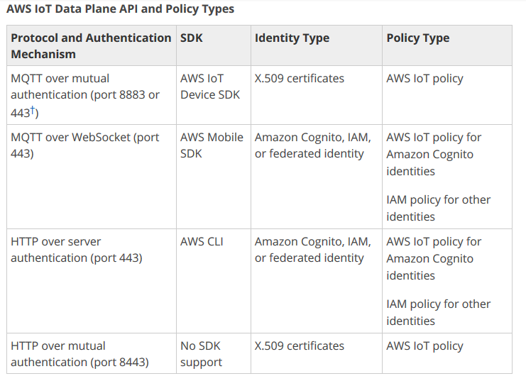

Slide 26
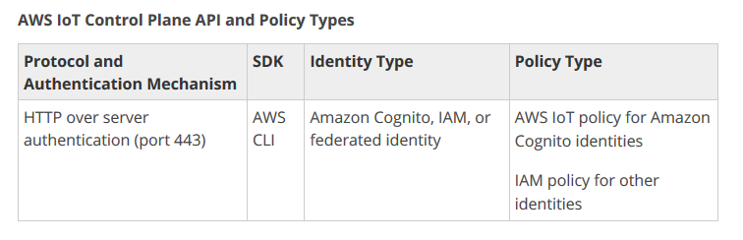

Slide 27
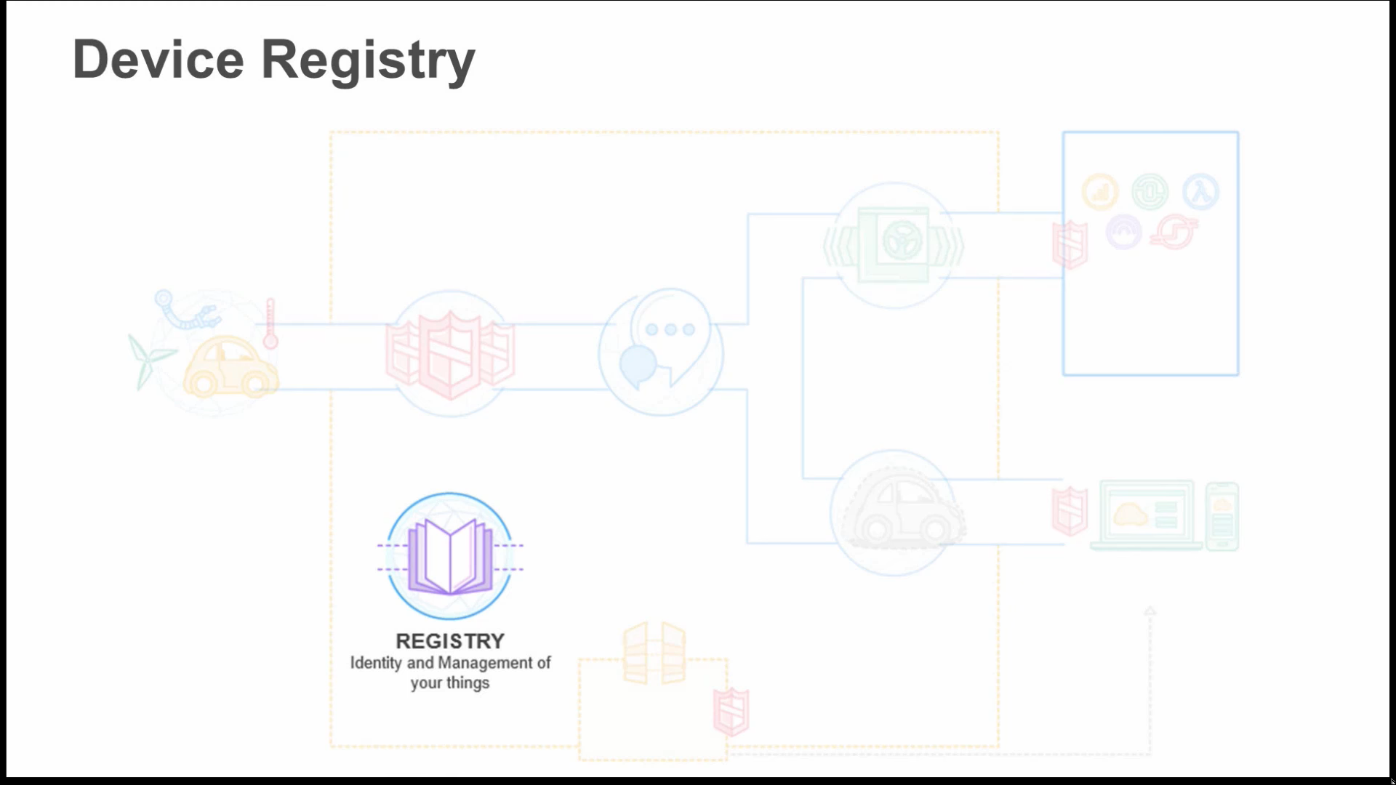

Slide 28
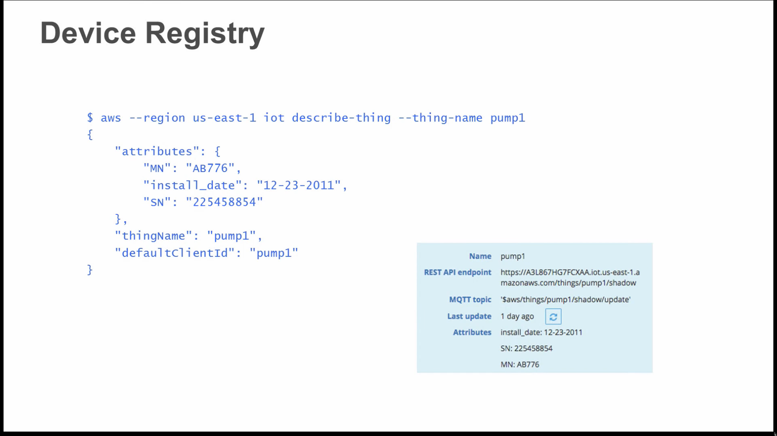
Cloud Region
Installation Time
Serial Number
Device Name

Slide 29
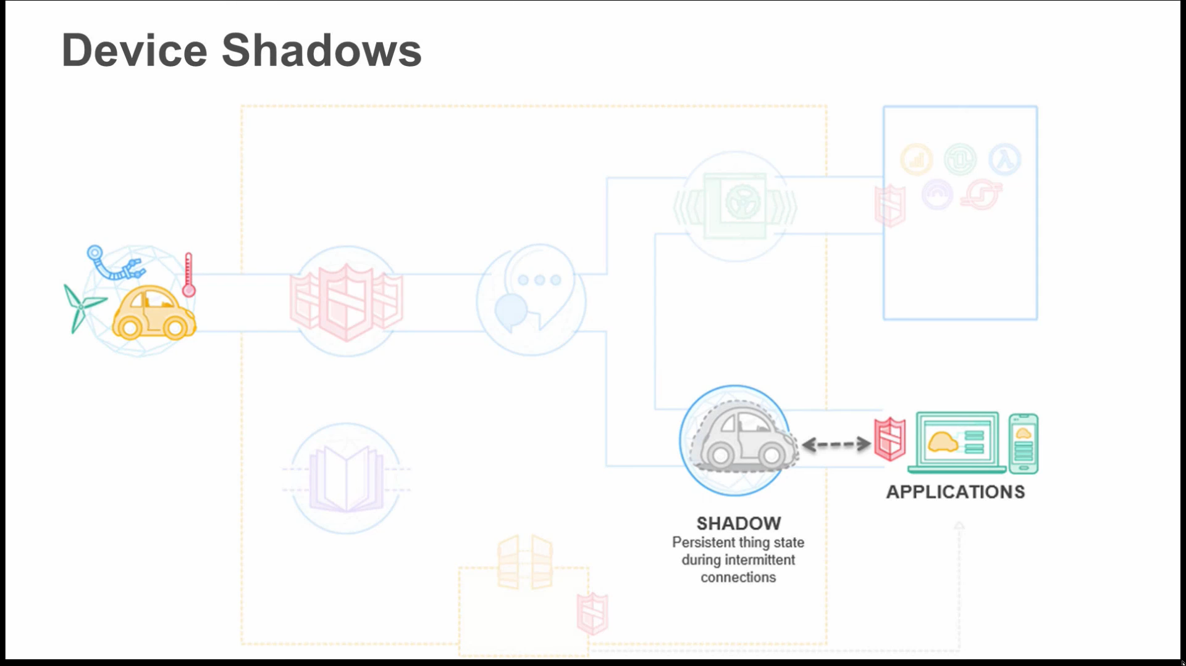

Slide 30
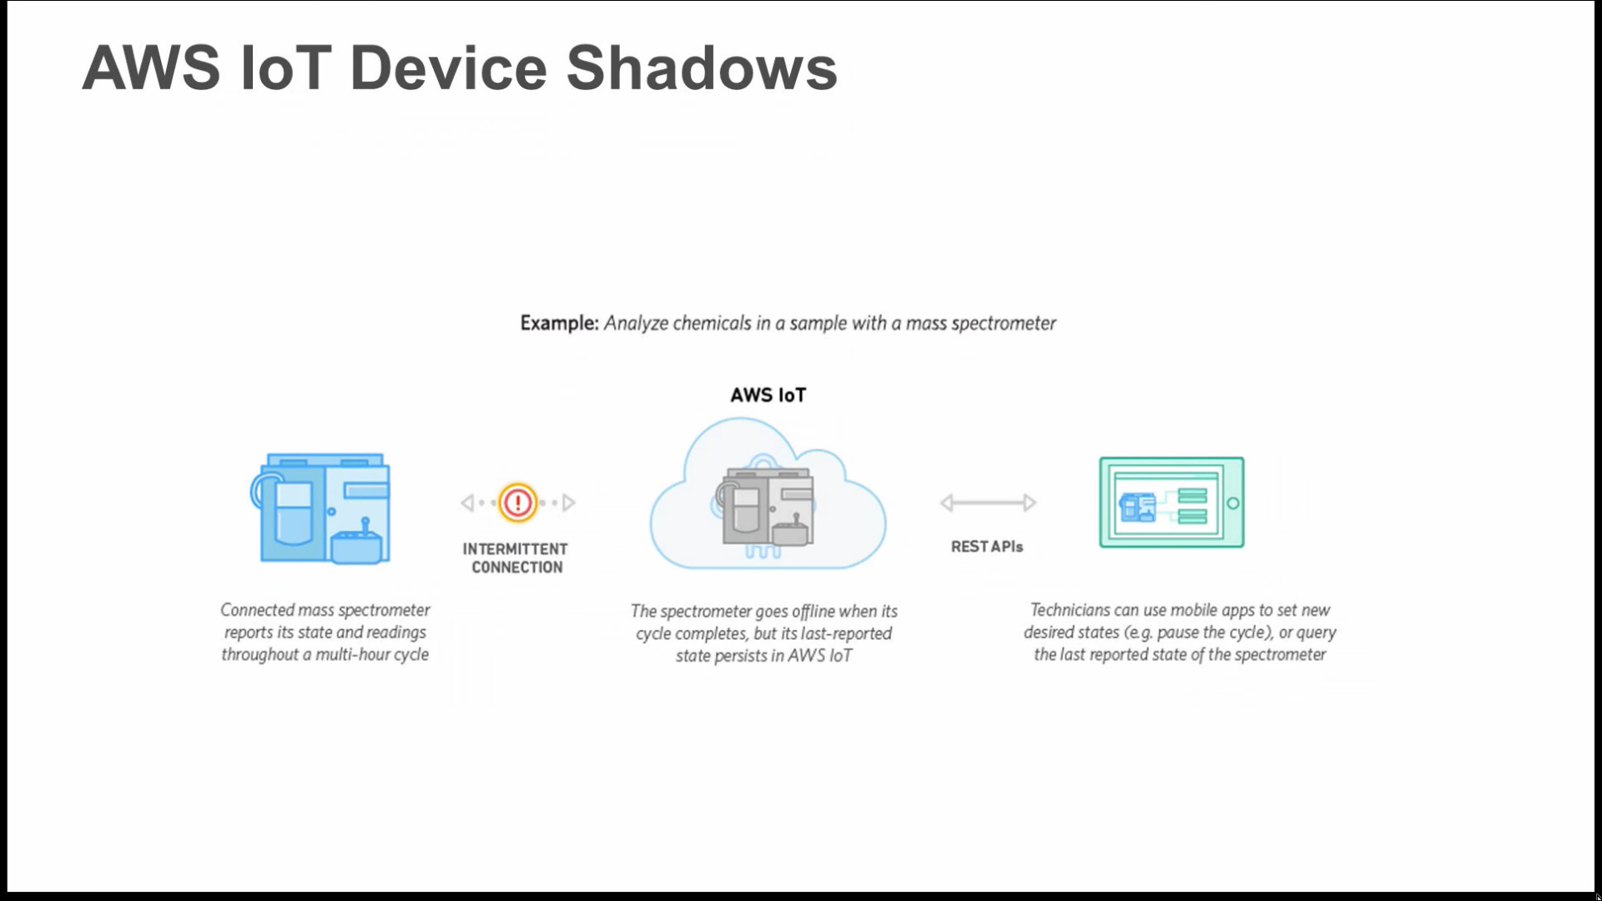

Slide 31
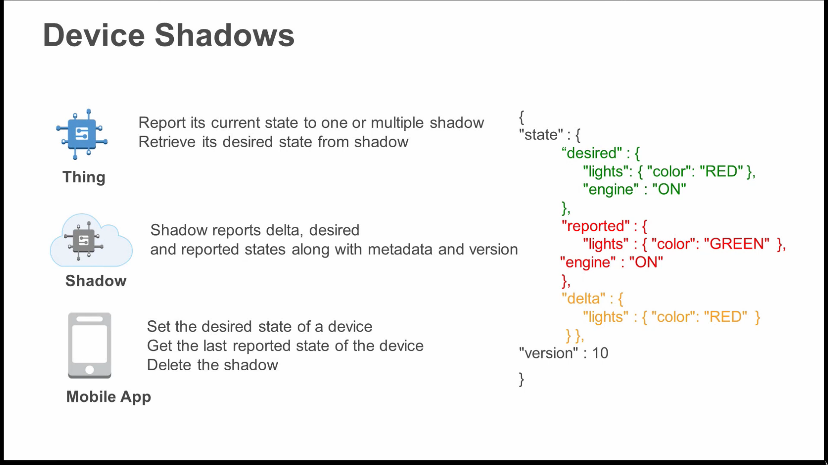

Slide 32
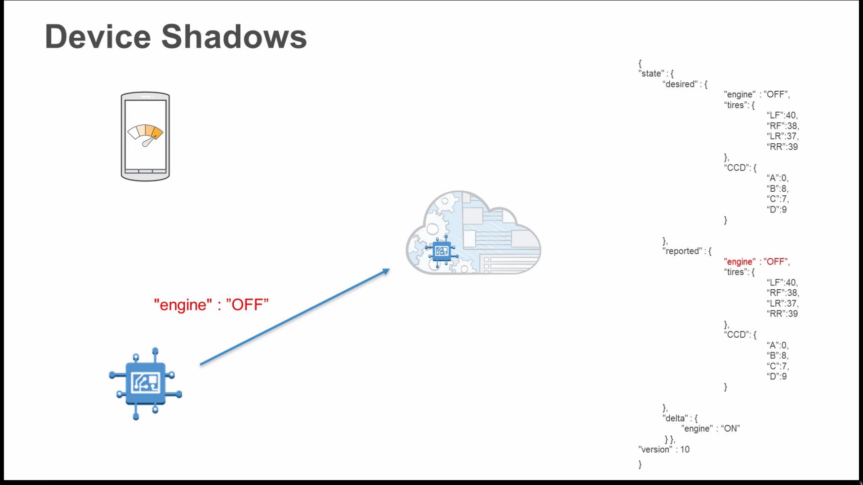

Slide 33
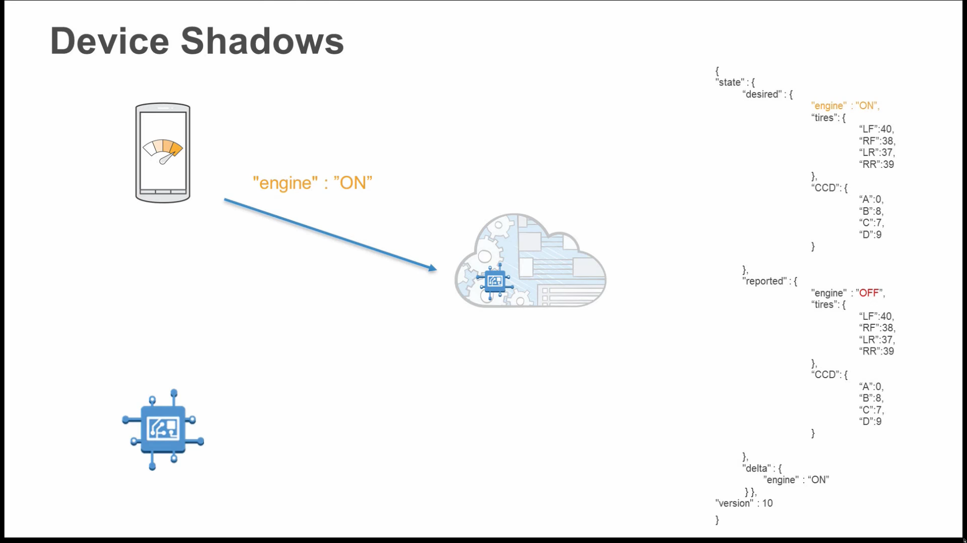

Slide 34
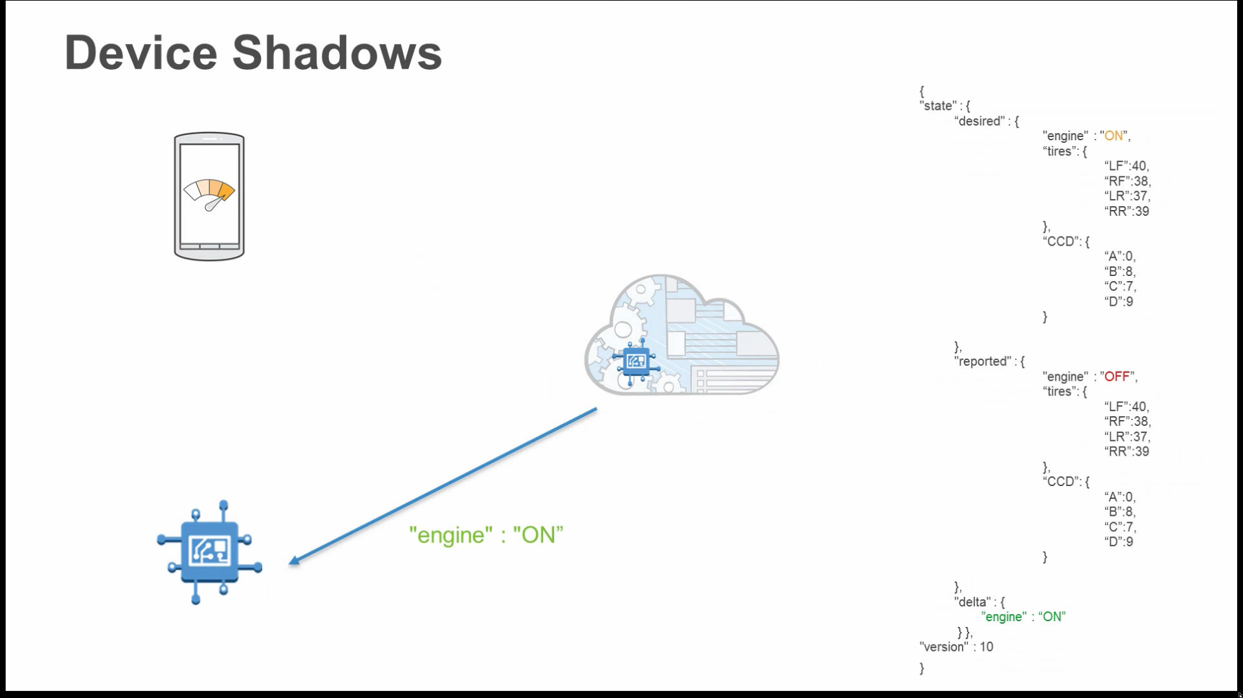

Slide 35
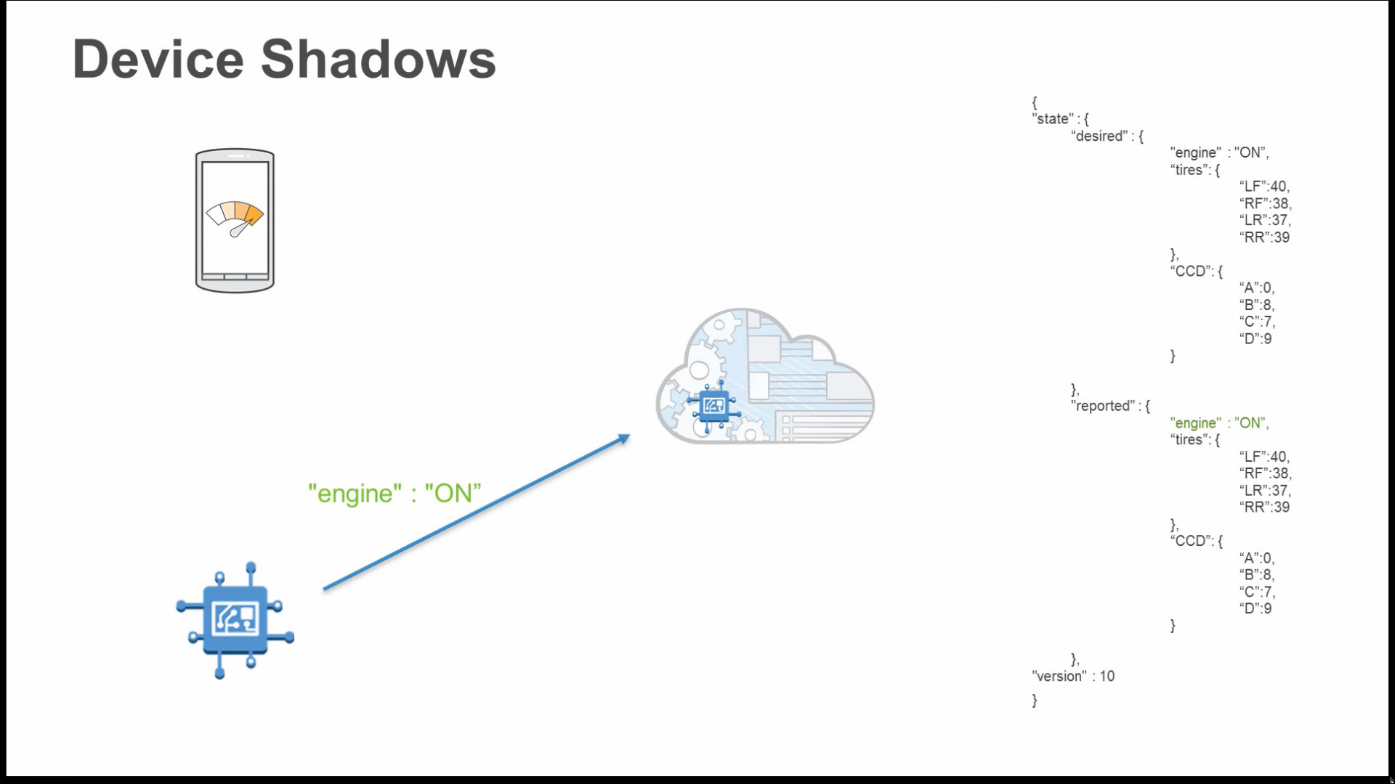

Slide 36
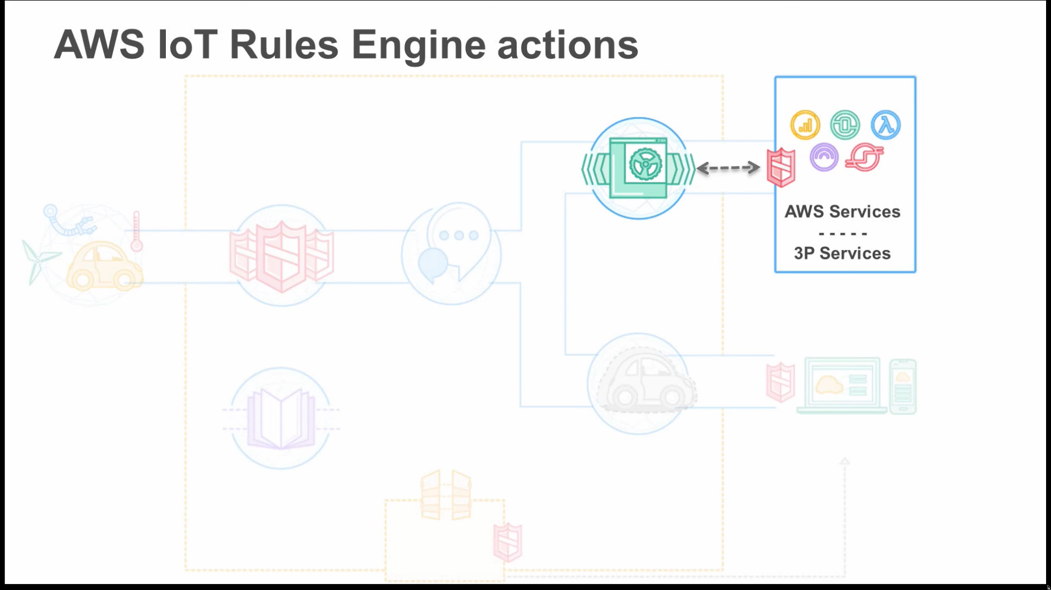
Analyze Data

Slide 37
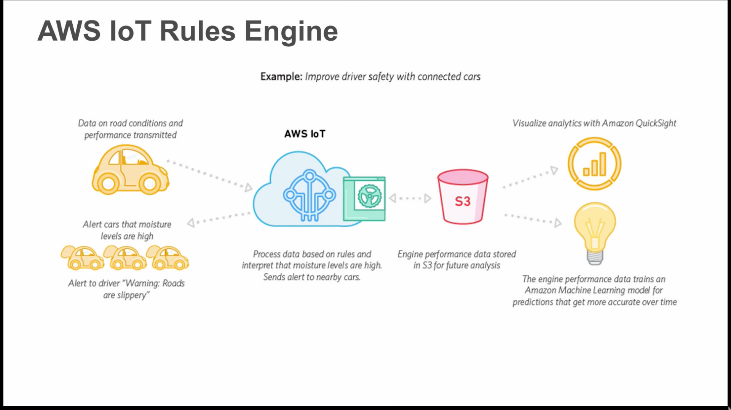

Slide 38
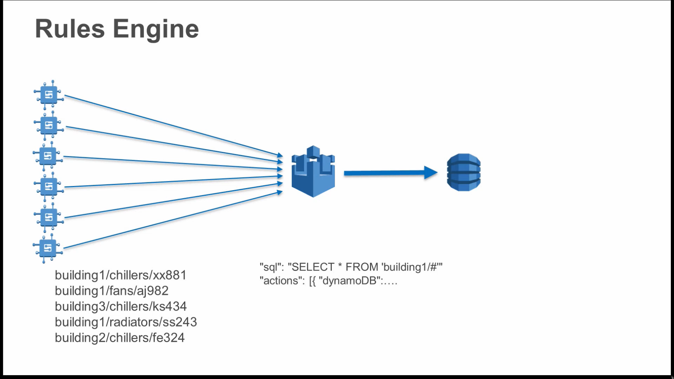
Create Rules:
SELECT
FILTER
TRANSFORM

Slide 39
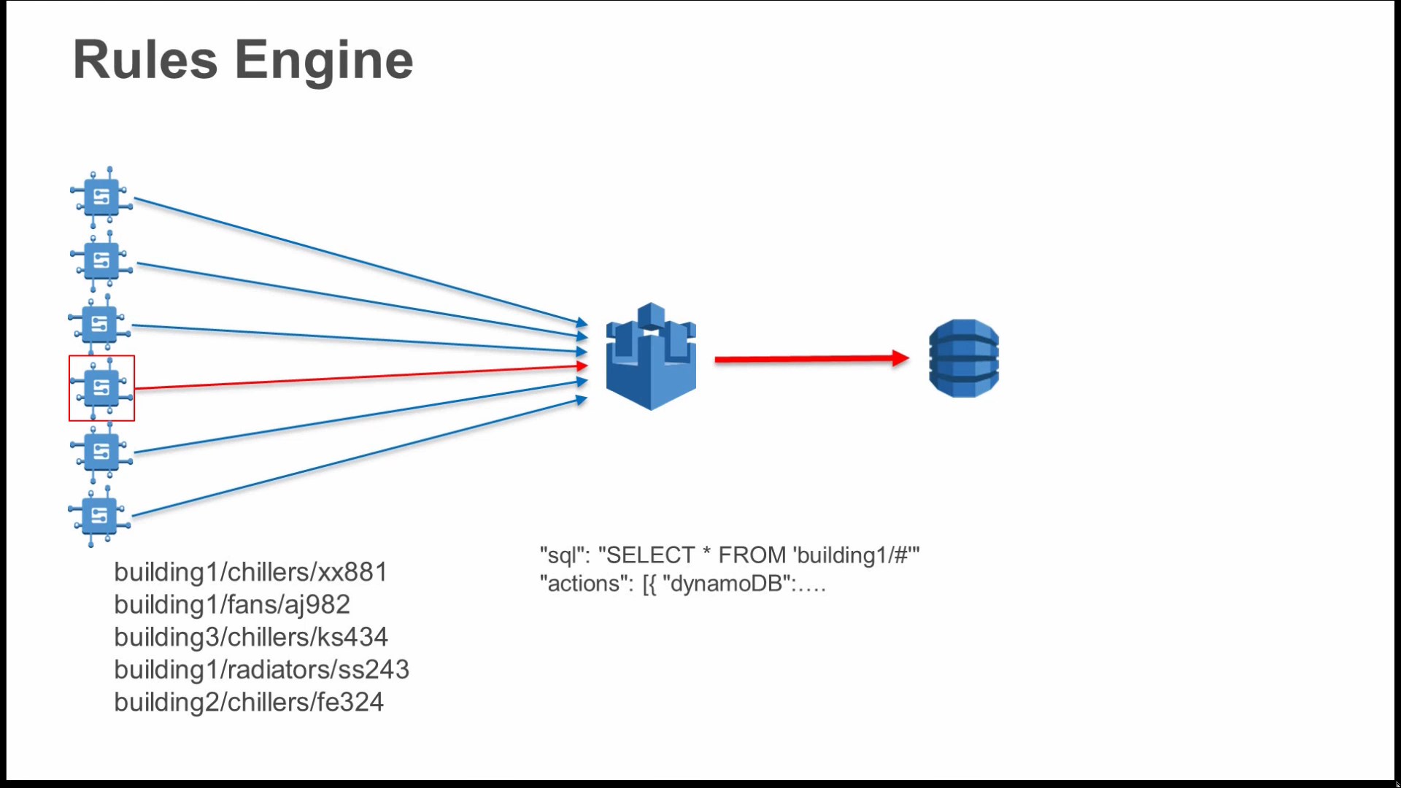

Slide 40
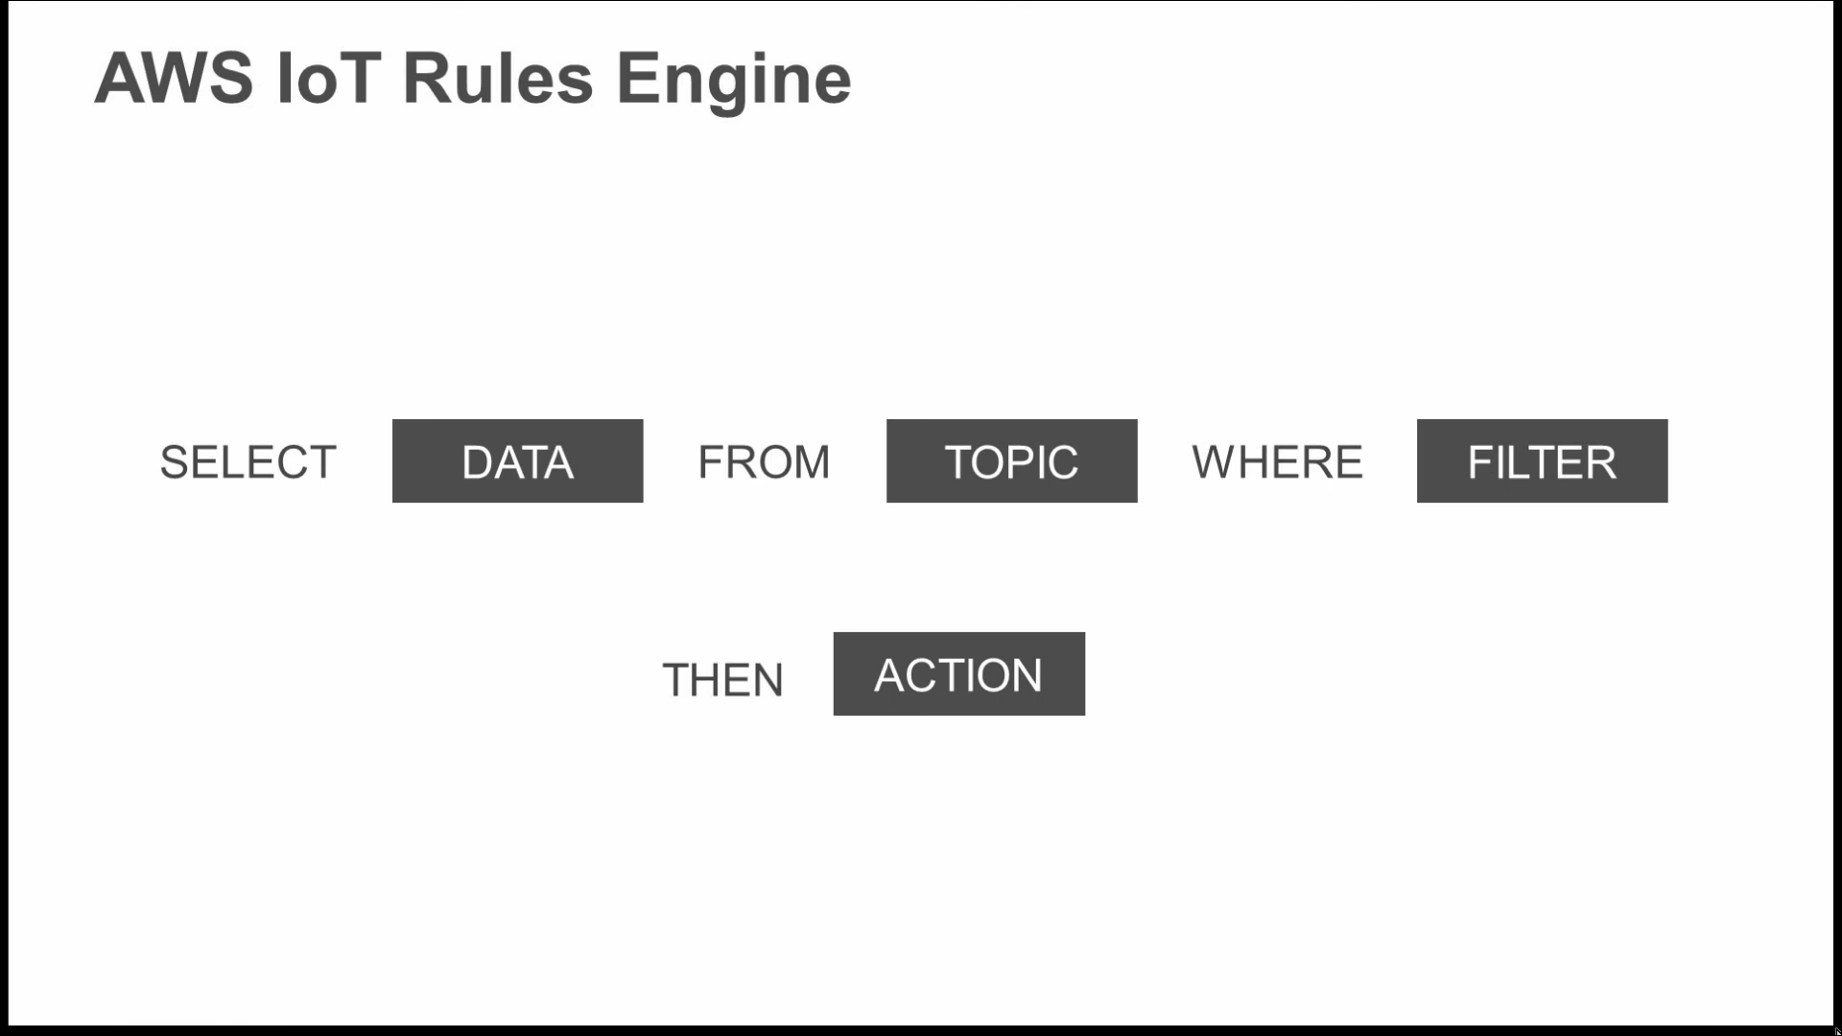

Slide 41
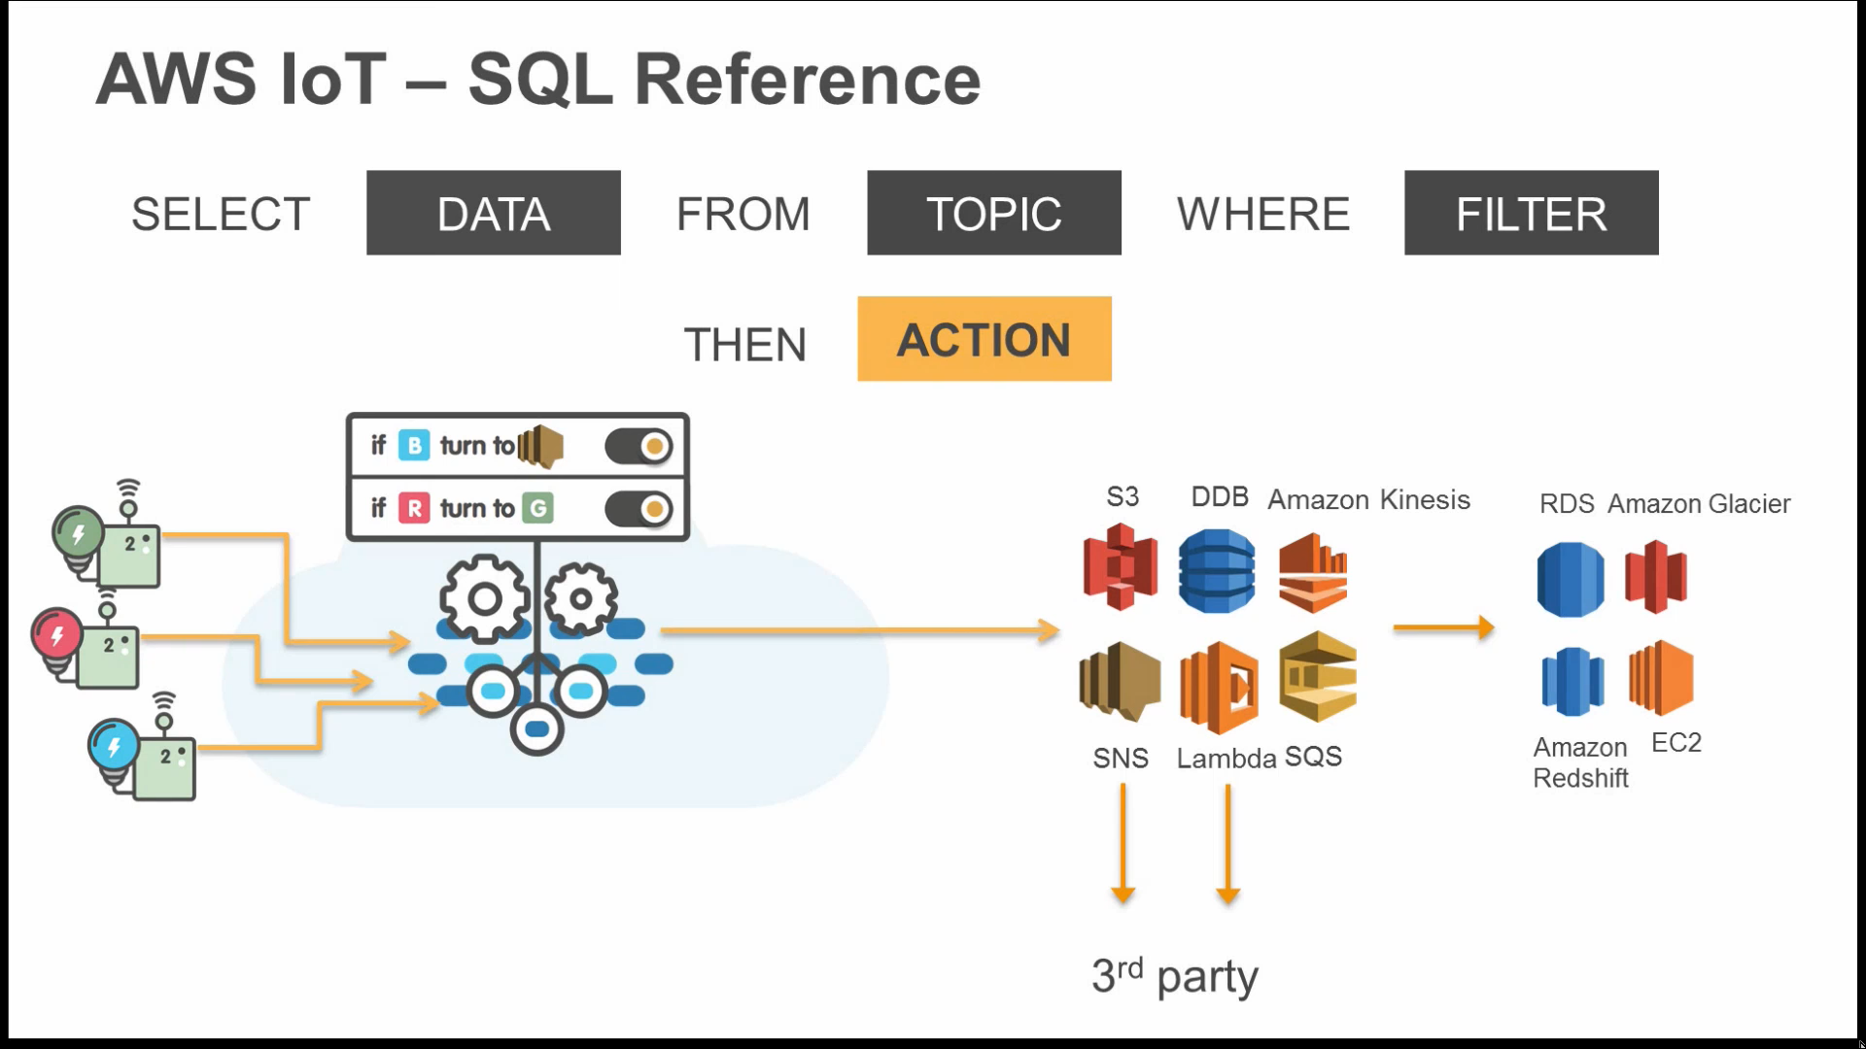

Slide 42
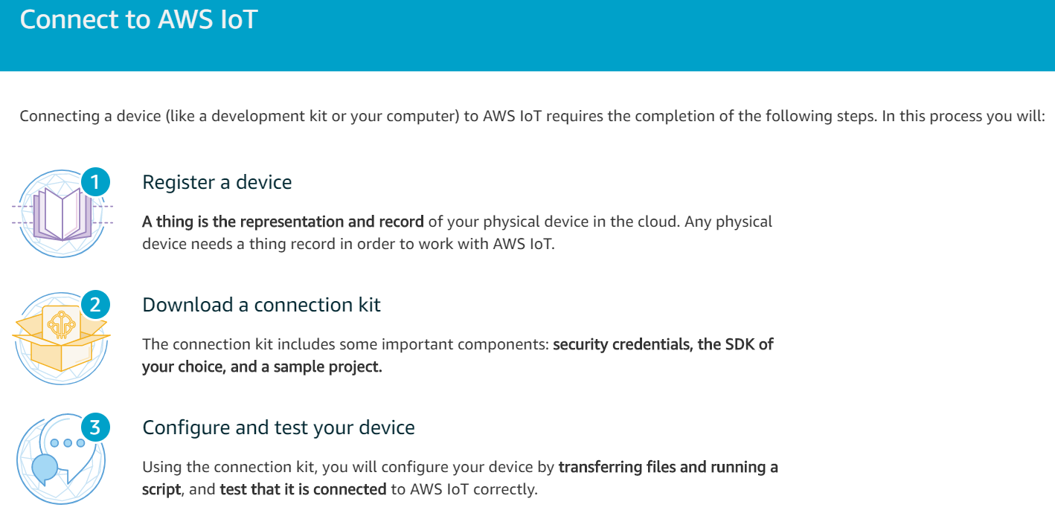

Slide 43
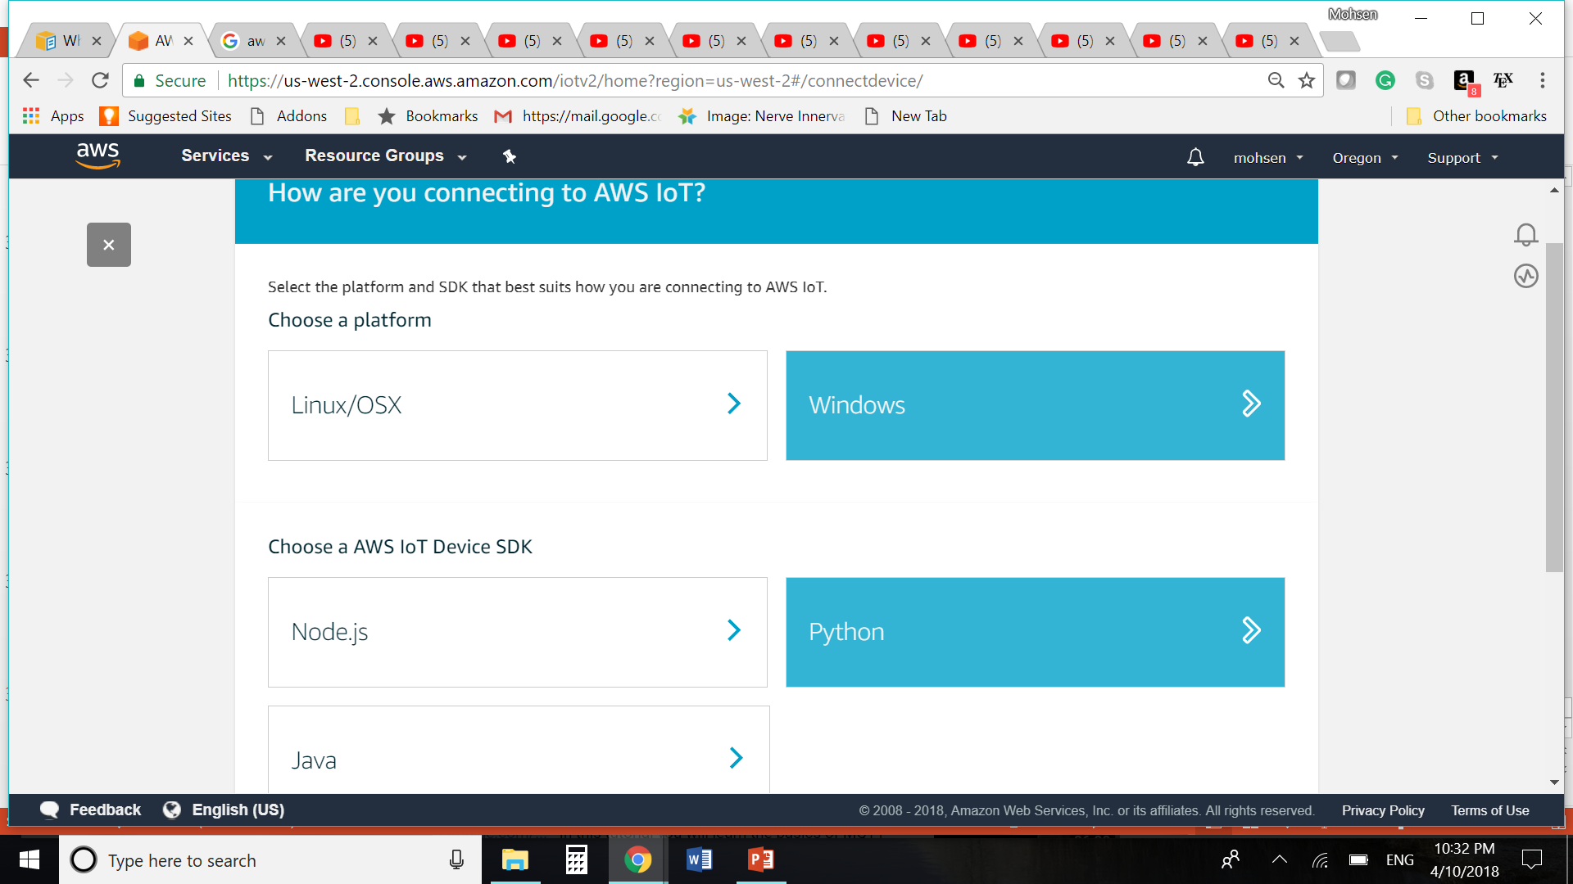
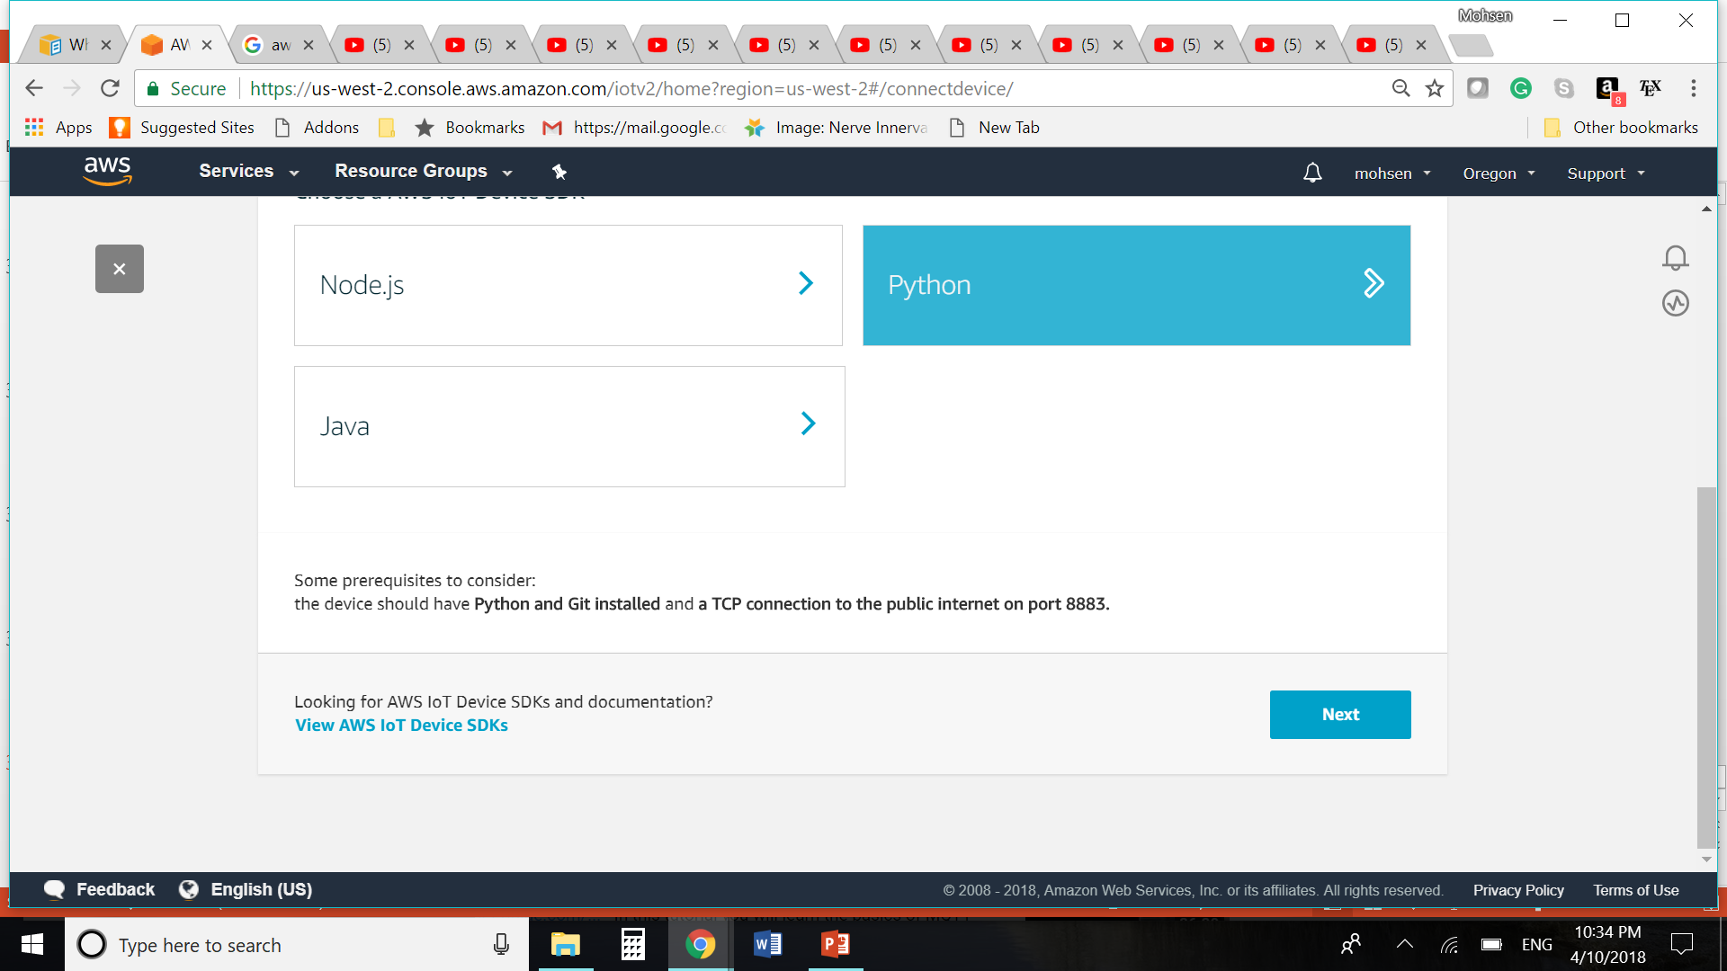

Slide 44
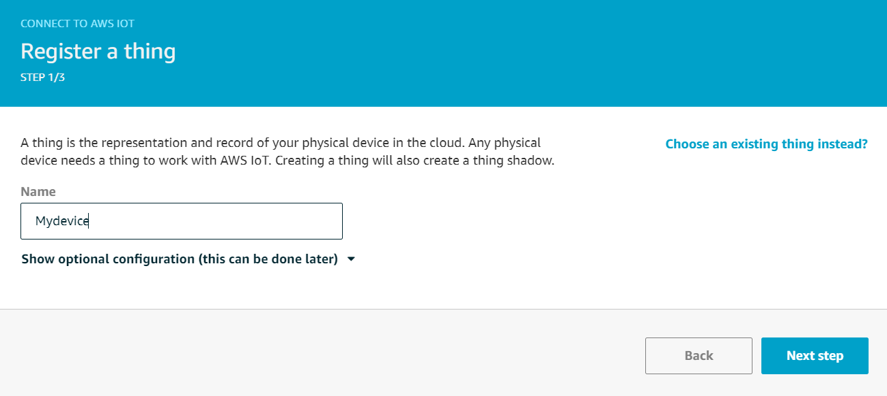

Slide 45
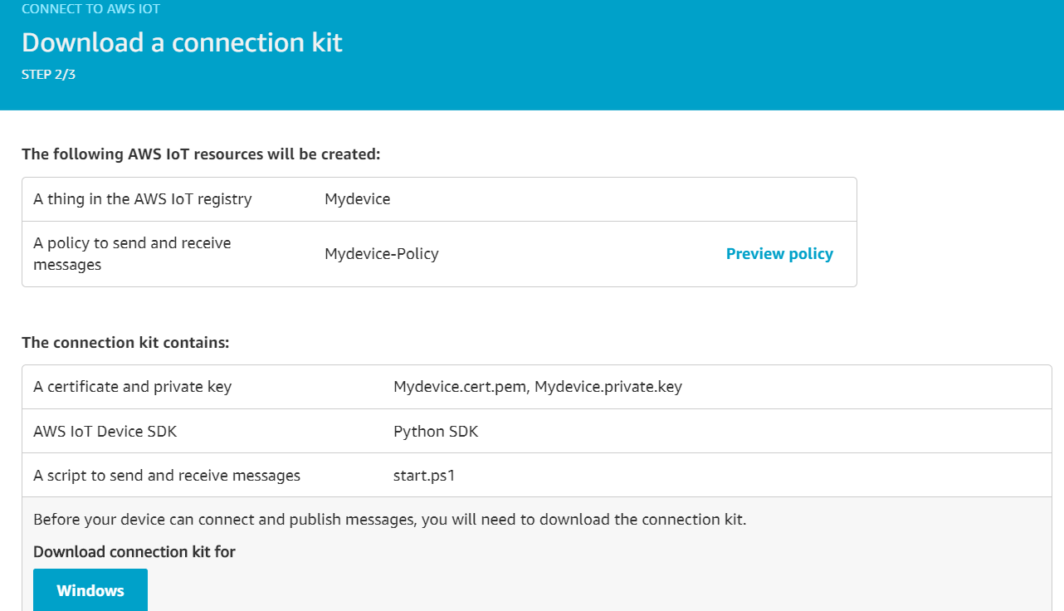

Slide 46
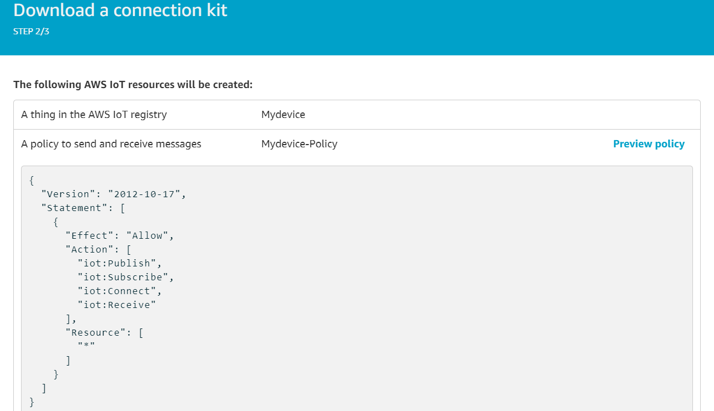

Slide 47
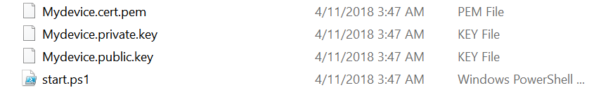
Certificate and Keys

Slide 48
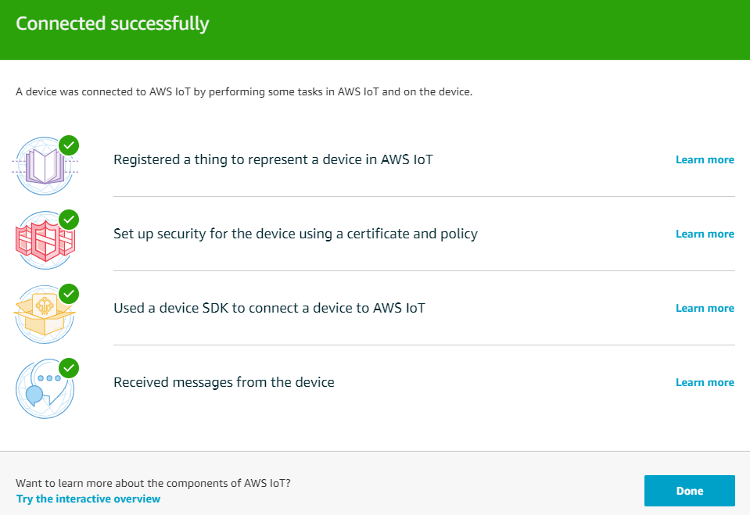

Slide 49
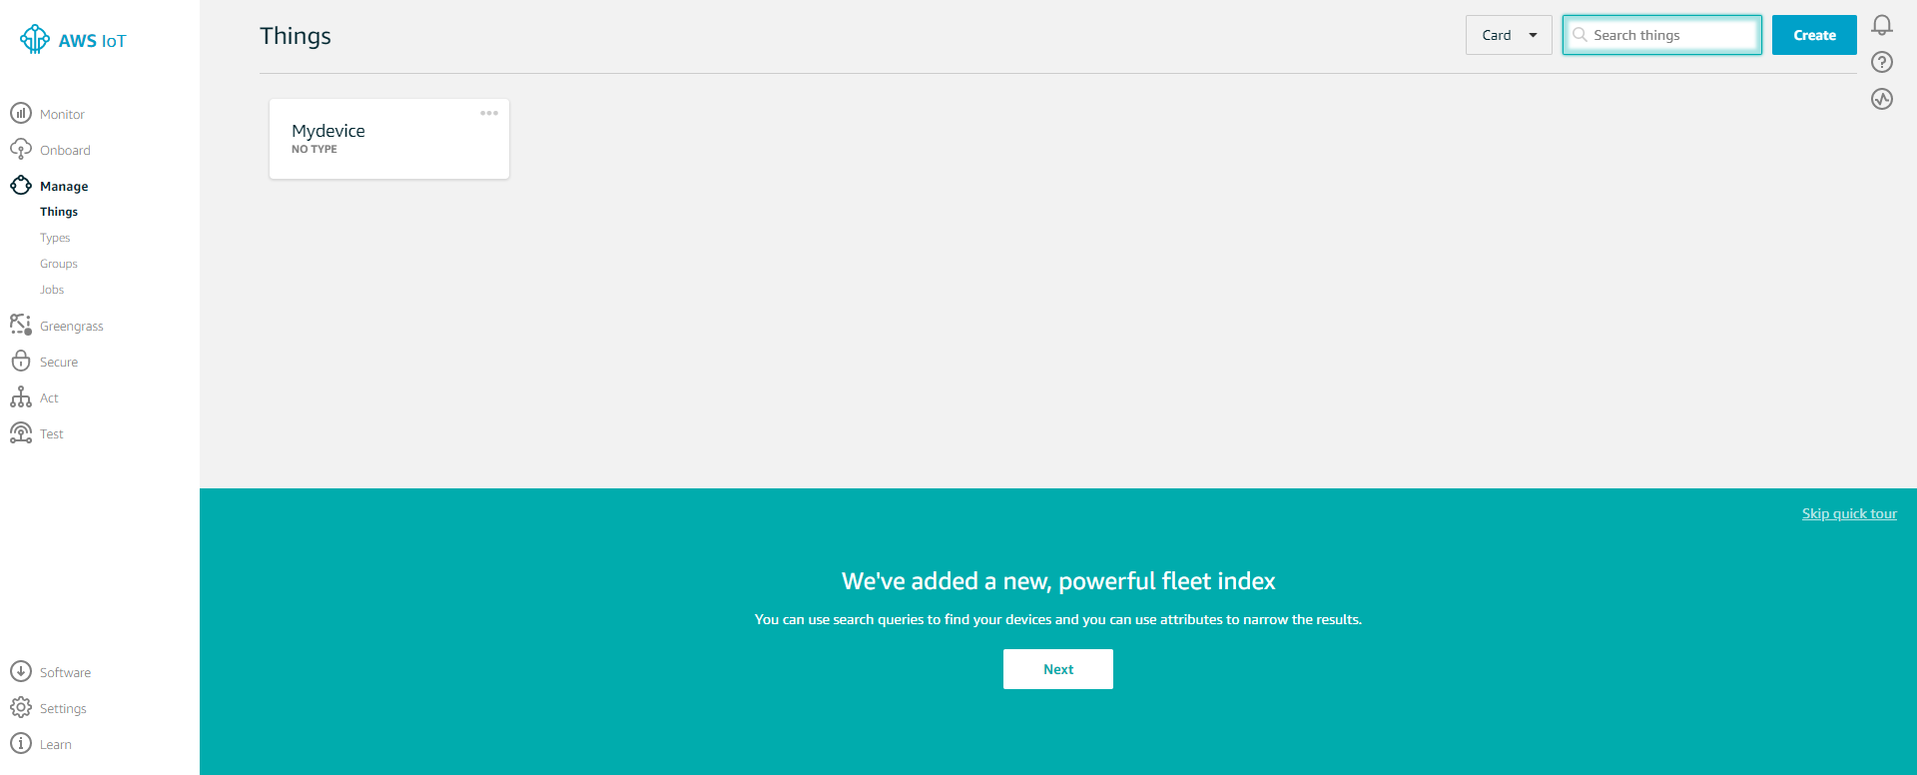

Slide 50
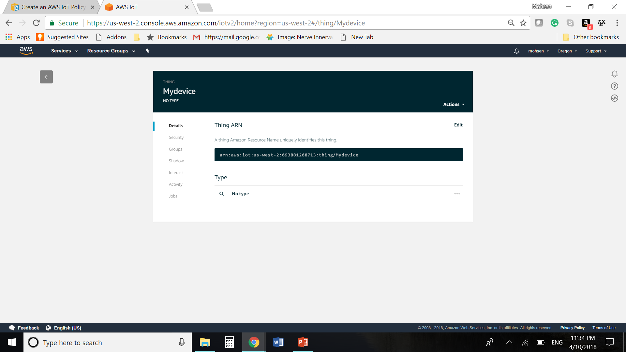
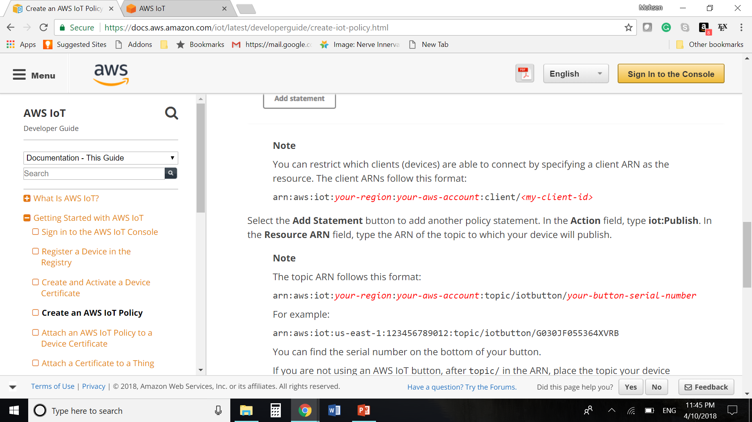

Slide 51
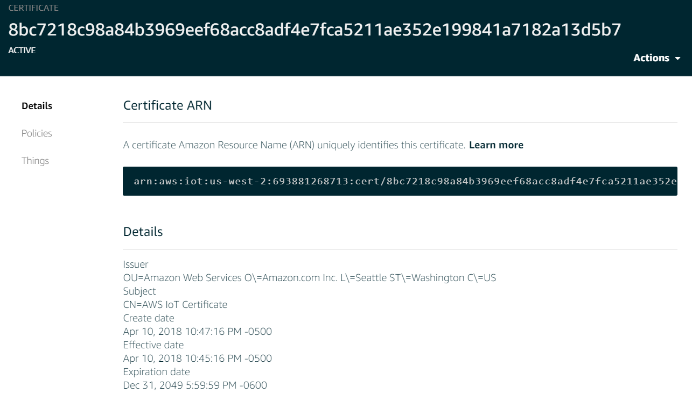

Slide 52
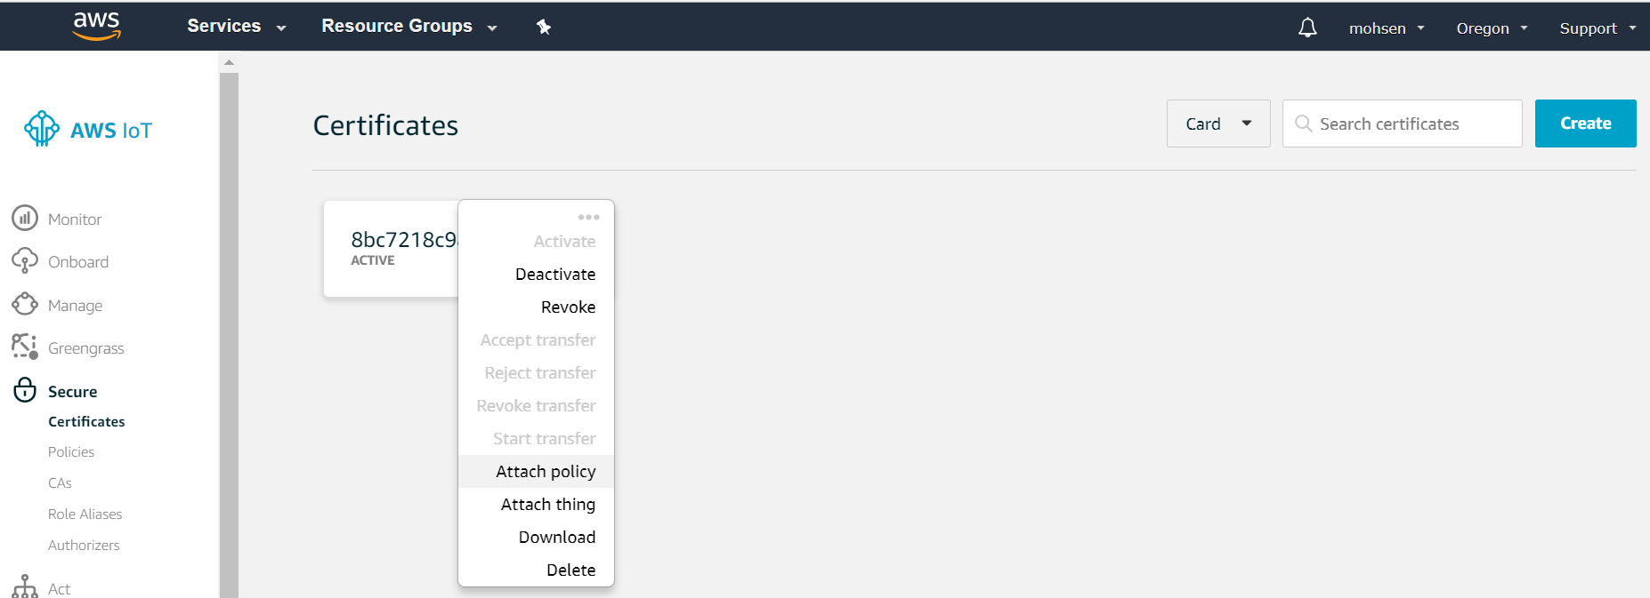

Slide 53
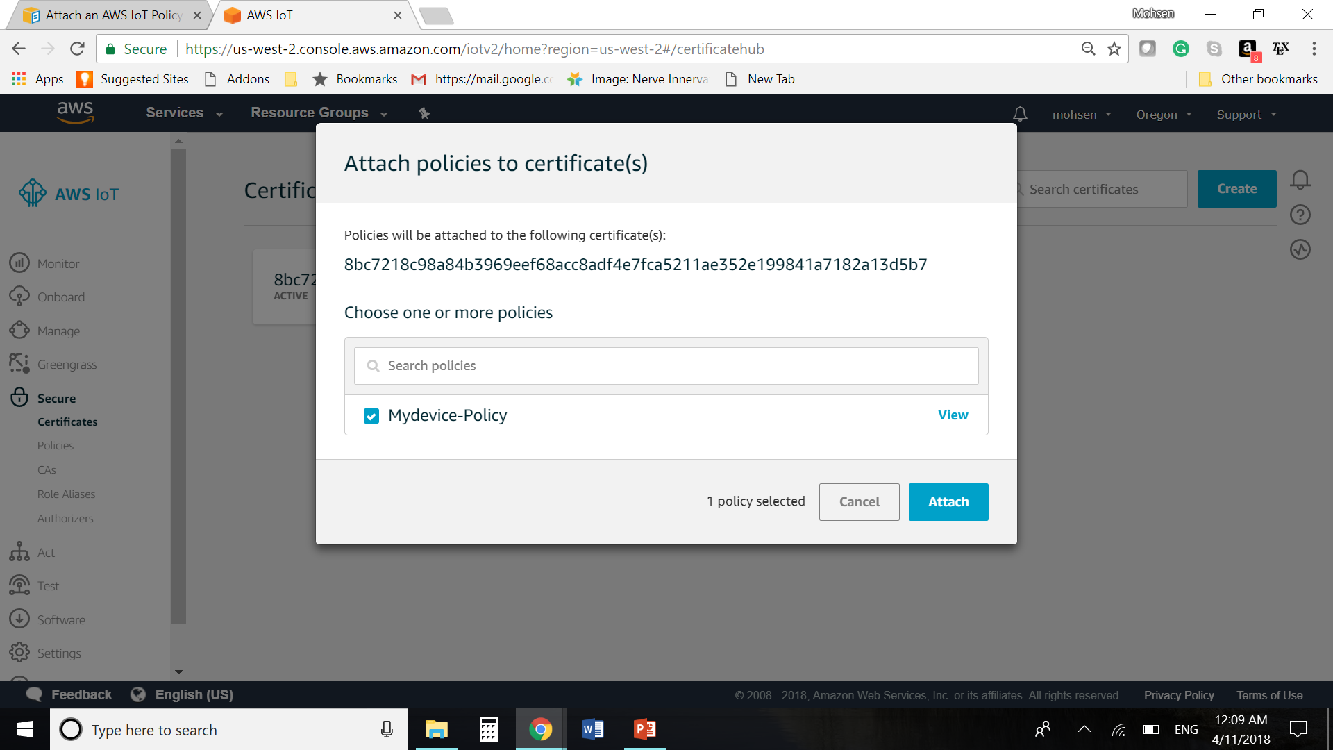

Slide 54


Slide 55


Slide 56
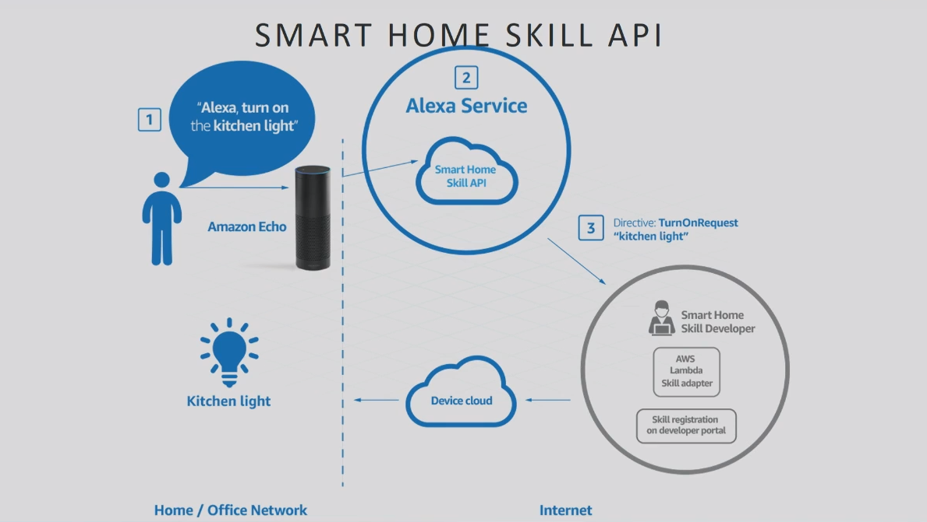

Slide 57
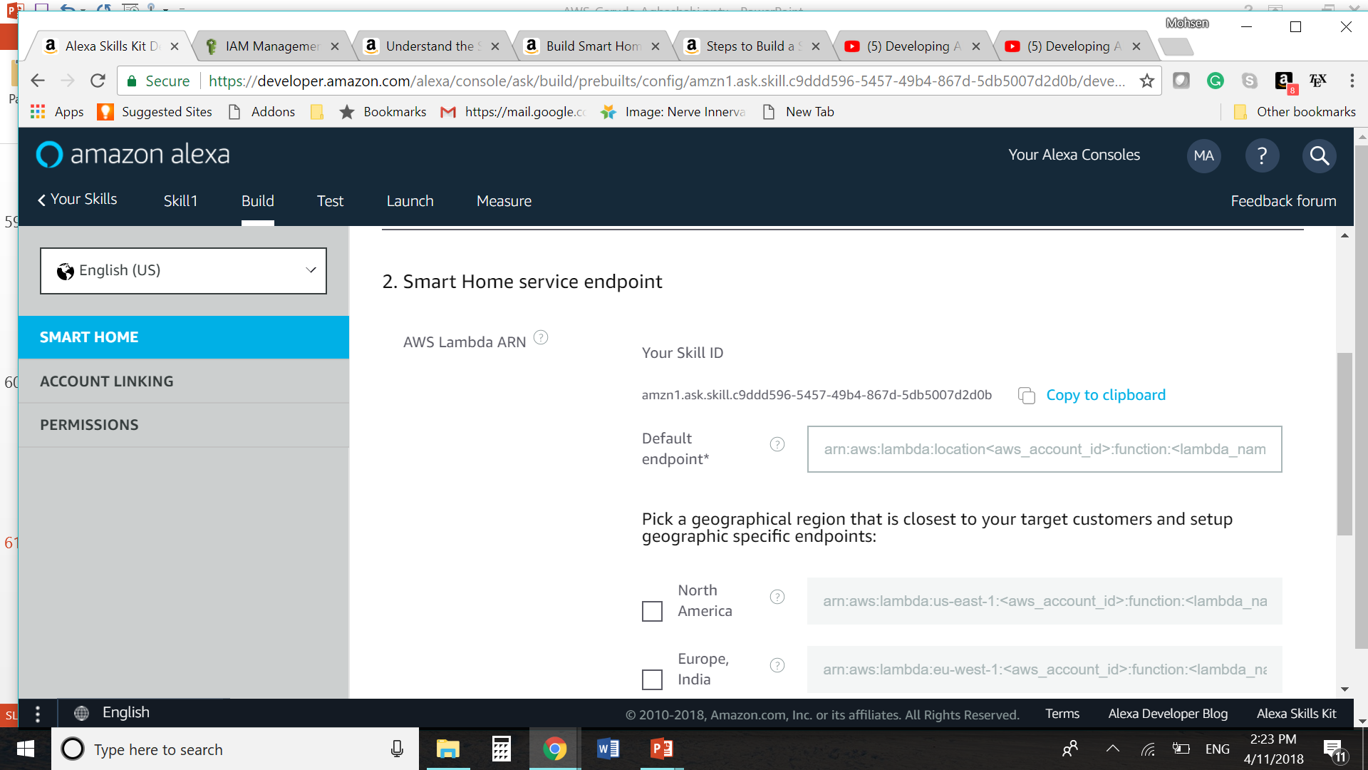
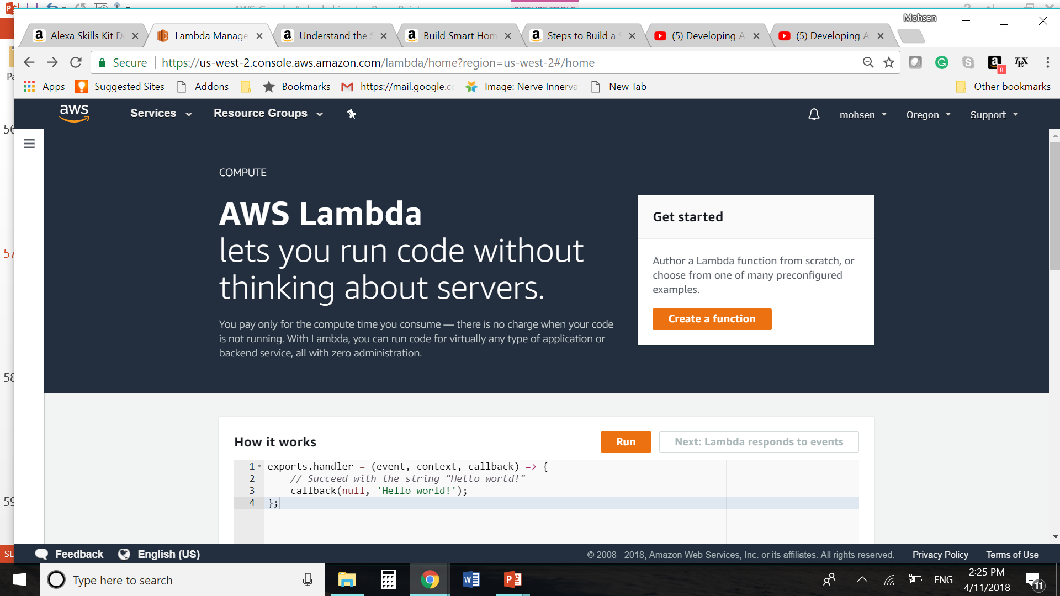

Slide 58
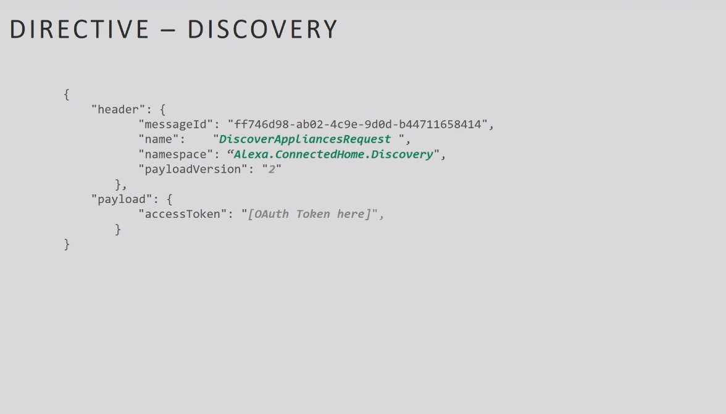

Slide 59


Slide 60

AWS IoT Bottun

Slide 61


https://www.youtube.com/watch?v=5AI4bnj41ng

Slide 62


Slide 63
Questions?

